Slide 1
Recent BGP Innovations for Operational Challenges
Job Snijders
job@ntt.net
NTT Communications

Slide 2
ITNOG BOLOGNA IS THE BEST!!!

Slide 3
Battle of Operations 2016 - 2017

Slide 4
Background
There’s been increased participation by operators in the IETF recently to standardize solutions to operational challenges with BGP
IDR (Inter-Domain Routing) Working Group
GROW (Global Routing Operations) Working Group
Several RFCs have been published, and several I-Ds are in the standardization process
Operators and implementers are working on solutions together in the WGs
This presentation provides an overview of some of the recent innovations in BGP
It’s never too late to participate, join the IDR and GROW mailing lists!
https://www.ietf.org/wg/

Slide 5
Agenda
Performance
draft-ietf-grow-bgp-gshut:
Reduce packet loss through cooperation
BGP
draft-ietf-grow-bgp-session-culling:
Reduce packet loss through correct procedures
Safety
RFC 8212: Apply secure EBGP policy defaults
Management
Coordination
RFC 8092: Signal large communities with 32-bit ASNs
RFC 8203: Send freeform message with BGP shutdown

Slide 6
RFC 8212 “Default External BGP (EBGP) Route Propagation Behavior without Policies”

Slide 7
Puzzle Time: What does this configuration do?
router bgp 64499
!
neighbor 192.0.2.1 remote-as 64555
neighbor 192.0.2.1 description Upstream 1
!
neighbor 192.0.2.5 remote-as 65444
neighbor 192.0.2.5 description Upstream 2
!

Slide 8
Puzzle Answer: Lateral AS-AS-AS Leak
Prefix P1
Prefix P2
AS 64555
AS 64500
AS 64499

Slide 9
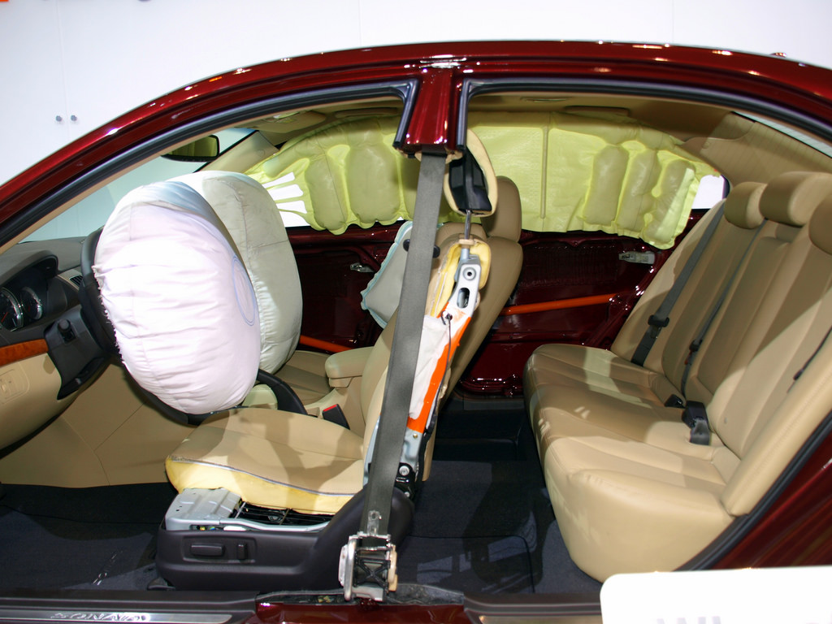
RFC 8212 in a Nutshell

Slide 10
Opponents Argued
“We can’t change defaults”
“It can’t be done”
”It will break everything we love and know”
Customers don’t read release notes
And don’t test whether the software boots
And deploy new software absolutely everywhere at once
And don’t follow NANOG / NLNOG / RIPE / Community mailing lists
And don’t talk to each other
…..

Slide 11
Post-RFC 8212 implication (hypothetical)
route-map implicit-deny-all deny 1
!
router bgp 64499
!
neighbor 192.0.2.1 remote-as 64555
neighbor 192.0.2.1 description Upstream 1
neighbor 192.0.2.1 route-map implicit-deny-all in
neighbor 192.0.2.1 route-map implicit-deny-all out
!
neighbor 192.0.2.5 remote-as 65444
neighbor 192.0.2.5 description Upstream 2
neighbor 192.0.2.5 route-map implicit-deny-all in
neighbor 192.0.2.5 route-map implicit-deny-all out

Slide 12
Advantages of RFC 8212
Consistency across platforms & vendors
Explicit configuration (‘grep’ suddenly is useful again)
Handover between personnel is easier as we don’t have to guess
Protects the Default-Free Zone (EBGP is a shared resource)

Slide 13
What This Means
BGP speakers that announce routes and/or accept routes, without explicitly being configured to do so, are no longer compliant with the core BGP specification
Current list of vendors that need to do some work
Cisco IOS
Cisco IOS XE
Cisco NX-OS
Arista EOS
Juniper Junos OS
Brocade Ironware
BIRD
OpenBGPD
Nokia SR OS
Others… (we’re keeping track here https://github.com/bgp/RFC8212)

Slide 14
Usage Guidelines
Start to implement a routing policy with secure EBGP defaults now
It’s the right thing to do and now is a good time to start
Keep an eye out for when your BGP implementations change their default behavior
Check release notes and documentation
Following these steps will ensure you are prepared in advance

Slide 15
Agenda
Performance
draft-ietf-grow-bgp-gshut:
Reduce packet loss through cooperation
BGP
draft-ietf-grow-bgp-session-culling:
Reduce packet loss through correct procedures
Safety
RFC 8212: Apply secure EBGP policy defaults
Management
Coordination
RFC 8092: Signal large communities with 32-bit ASNs
RFC 8203: Send freeform message with BGP shutdown

Slide 16
Needed RFC 1997 Style Communities, but Larger
We knew we’d run out of 16-bit ASNs eventually and came up with 32-bit ASNs
RIRs started allocating 32-bit ASNs by request in 2007, no distinction between 16-bit and 32-bit ASNs now
However, you can’t fit a 32-bit value into a 16-bit field
Can’t use native 32-bit ASNs with RFC 1997 communities
Needed an Internet routing communities solution for 32-bit ASNs for almost 10 years
Parity and fairness so everyone can use their globally unique ASN

Slide 17
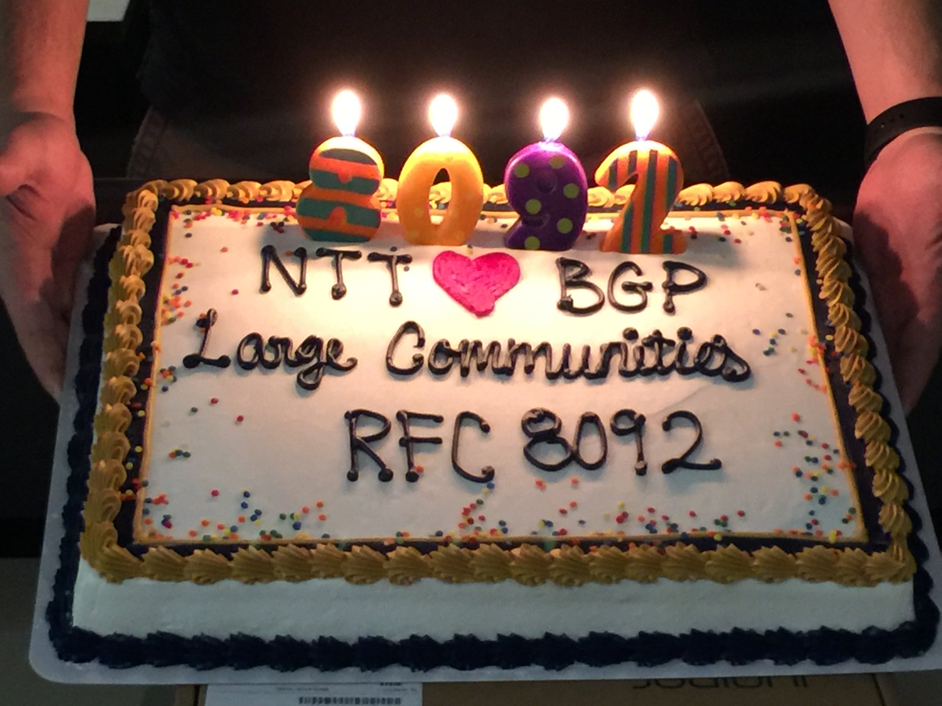
RFC 8092 “BGP Large Communities Attribute”
Idea progressed rapidly from inception in March 2016
First I-D in September 2016 to RFC publication on February 16, 2017 in just seven months
Final standard, plus a number of implementation and tools developed as well
Network operators can test and deploy the new technology now
Cake and photo courtesy of the NTT Communications NOC.

Slide 18
Getting Started With Large Communities
2018 is the year of large BGP communities
Preparation, testing, training and deployment can take weeks, months or even over a year
Start the work now, so you are ready when customers want to use large communities
Lots of resources are available to help network operators learn about large communities at http://largebgpcommunties.net/
BGP speaker implementations
Analysis and ecosystem tools
Presentations (http://largebgpcommunities.net/talks/)
Documentation for each implementation
Configuration examples (http://largebgpcommunities.net/examples/)
RFC 8195 provides examples and inspiration for network operators to use large communities

Slide 19
Agenda
Performance
draft-ietf-grow-bgp-gshut:
Reduce packet loss through cooperation
BGP
draft-ietf-grow-bgp-session-culling:
Reduce packet loss through correct procedures
Safety
RFC 8212: Apply secure EBGP policy defaults
Management
Coordination
RFC 8092: Signal large communities with 32-bit ASNs
RFC 8203: Send freeform message with BGP shutdown

Slide 20
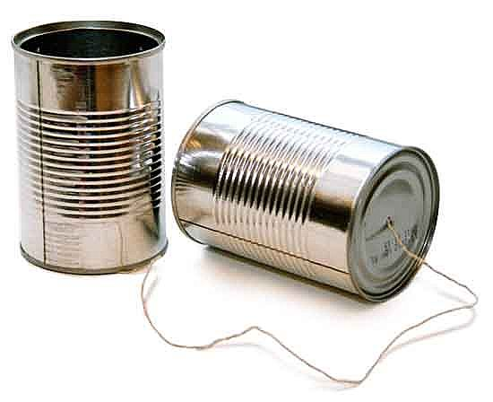
Communication can be a Challenge

Slide 21
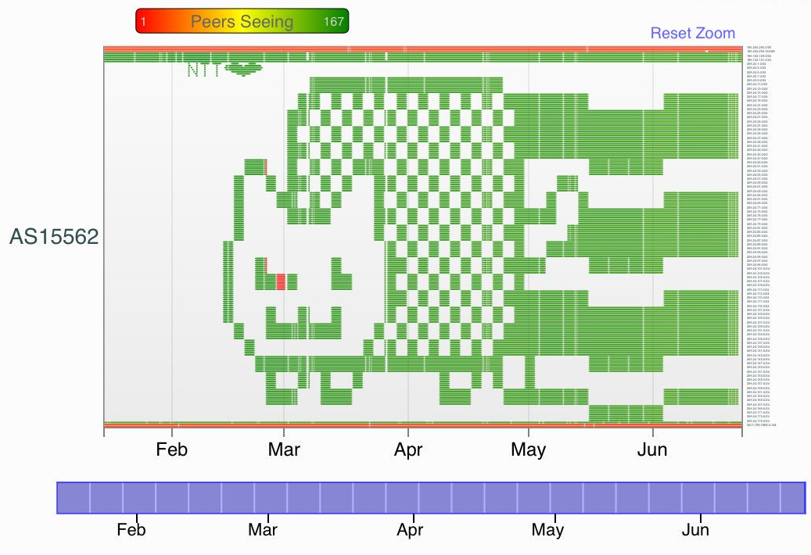
https://labs.ripe.net/Members/cteusche/bgp-meets-cat

Slide 22
RFC 8203 “BGP Administrative Shutdown Communication”
?
X
?
Probably Didn’t Read Maintenance Notice
Maintenance
?
AS 64496
AS 64511
Coordination problem: you shutdown your BGP session and your peers don’t know why
Solution: add a freeform message embedded in the BGP NOTIFICATION message when the session is shutdown

Slide 23
RFC 8203 “BGP Administrative Shutdown Communication”
💡
X
Maintenance
☺
AS 64496
AS 64511
NOTIFICATION Cease "[TICKET-1-1438367390] software upgrade; back in 2 hours”
Message can be up to 128 bytes long
UTF-8 is supported too: 💩🦄😍😡👭😺👬

Slide 24
Usage Guidelines
Sender
Receiver
Send “Administrative Shutdown” message for maintenance that is going to take some period of time
Send “Administrative Reset” message for maintenance that is for a short time, for example to reset a peer or to reboot a router
Include a ticket or reference number and make the message as informative as possible
Log messages to logging systems
Reference ticket number in email or other notifications for more details

Slide 25
OpenBGPD Example
Sender:
[job@kiera ~]$ bgpctl neighbor 165.254.255.24 down "[TICKET-1-1438367390] we are upgrading to openbsd 6.1, be back in 30 minutes”
[job@kiera ~]$
Receiver:
Jan 8 19:28:54 shutdown bgpd[50719]: neighbor 165.254.255.26: received notification: Cease, administratively down
Jan 8 19:28:54 shutdown bgpd[50719]: neighbor 165.254.255.26: received shutdown reason: "[TICKET-1-1438367390] we are upgrading to openbsd 6.1, be back in 30 minutes"

Slide 26
Implementation Status
Implementation | Software | Status
cz.nic | BIRD | Unknown
Cisco | IOS XR | Unknown
ExaBGP | ExaBGP | ✔ Done!
FreeRangeRouting | frr | ✔ Done!
OSRG | GoBGP | ✔ Done!
Juniper | Junos OS | Unknown
Nokia | SR OS | Unknown
OpenBSD | OpenBGPD | ✔ Done!
OSRG | GoBGP | ✔ Done!
pmacct.net | pmacct | ✔ Done!
tcpdump.org | tcpdump | ✔ Done!
Wireshark | Dissector | ✔ Done!

Slide 27
Agenda
Performance
Security
draft-ietf-grow-bgp-gshut:
Reduce packet loss through cooperation
BGP
RFC 7999:
Signal destination-based blackholing
draft-ietf-grow-bgp-session-culling:
Reduce packet loss through correct procedures
Safety
RFC 8212: Apply secure EBGP policy defaults
Management
Coordination
RFC 8092: Signal large communities with 32-bit ASNs
RFC 8203: Send freeform message with BGP shutdown

Slide 28
Two Types of Maintenance
Voluntary Shutdown (YOU)
Involuntary Shutdown (other folks)
You take action before maintenance to reroute traffic and minimize the impact
You use BGP shutdown communication
You use graceful BGP session shutdown
Maintenance on lower layer network breaks end-to-end path, but link stays up
BGP sessions only go down after hold timer expires
Could blackhole traffic during this time until traffic is rerouted
Your network provider uses BGP culling

Slide 29
When does blackholing happen with vanilla shutdown?
RR
Lack of an alternative route on some routers
Transient routing inconsistency
A route reflector may only propagate its best path
The backup ASBR may not advertise the backup path because the nominal path is preferred
Admittedly, the above scenarios usually are short periods of blackholing, but why accept that if they can easily be prevented?
2) withdraw
3) New path
Steady announce
ASBR
ASBR
Steady announce
1) Shutdown (cease)
Peer

Slide 30
Graceful Shutdown triggers “path hunting”
RR
Initiated by the operator on the router before maintenance by sending the GRACEFUL_SHUTDOWN well-known community (65535:0 as per IANA)
Receiving EBGP peer sets LOCAL_PREFERENCE to 0 and selects paths to route traffic away from the initiator, (similar to setting overload in an ISIS)
When BGP session goes down, minimizes impact to traffic because alternate paths have already been installed
2) ANNOUNCE with LP=0
3) Receive New path from RR
Steady announce
ASBR
ASBR
1) Signal “lower LOCAL_PREF” 4) shutdown session (cease)
Peer

Slide 31
Usage Guidelines
To support receiving graceful shutdown, update your routing policy to
Match the GRACEFUL_SHUTDOWN well-known community (65535:0)
Set the LOCAL_PREF attribute to a low value, like 0
To send graceful shutdown, update your routing policy to
Send the GRACEFUL_SHUTDOWN well-known community (65535:0) before you start maintenance
When ingress traffic from the peer has stopped, start maintenance and use BGP shutdown communication
Remove the GRACEFUL_SHUTDOWN well-known community when you are done

Slide 32
Configuration Example – Simple to Implement
IOS XR
Arista/Brocade/IOS/Quagga/FRR
route-policy AS64497-ebgp-inbound
if community matches-any (65535:0) then
set local-preference 0
endif
end-policy
!
router bgp 64496
neighbor 2001:db8:1:2::1
remote-as 64497
address-family ipv6 unicast
send-community-ebgp
route-policy AS64497-ebgp-inbound in
ip community-list standard gshut 65535:0
!
route-map ebgp-in permit 10
match community gshut
set local-preference 0
Nokia
community "gshut" members "65535:0"
policy-statement "ebgp-in"
entry 10
from
community "gshut"
exit
action accept
local-preference 0
exit
exit
exit

Slide 33
GRACEFUL_SHUTDOWN signals:
“Hello everyone, if you consider this path your ‘best path’,
please start considering this path the ’worst path’
and if you find anything better install that into your FIB.
This path will disappear within a few minutes.”
Operators known to honor the graceful_shutdown well-known community:
NTT (AS 2914)
GTT (AS 3257)
Github (AS 36459)
Nordunet (AS 2603)
Coloclue (AS 8283)
Amsio (AS 8315)
BIT (AS 12859)
Telia (AS 3301/1299)
Tele2 (AS 1257)
SVT (AS 201641)
Netnod (AS 8674)
Bahnhof (AS 8473)
DGC Systems (AS 21195)
ComHem (AS 39651)
… you? ☺

Slide 34
draft-ietf-grow-bgp-session-culling “Mitigating Negative Impact of Maintenance through BGP Session Culling”
Link up
Traffic is Dropped
Link up
Traffic is Dropped
Maintenance
X
BGP is up
Until Hold Timer Expires
BGP is up
Until Hold Timer Expires
AS 64496
AS 64511
Layer 2 Network
Performance problem: maintenance on lower layer network breaks path, but link stays up
Solution: network provider applies Layer 4 ACLs to block BGP control plane traffic while links are up
Routers continue to forward traffic until hold timer expires, no blackholing

Slide 35
draft-ietf-grow-bgp-session-culling “Mitigating Negative Impact of Maintenance through BGP Session Culling”
ACL Blocks BGP
Traffic is Forwarded
ACL Blocks BGP
Traffic is Forwarded
Maintenance
X
BGP is up
Until Hold Timer Expires
BGP is up
Until Hold Timer Expires
AS 64496
AS 64511
Layer 2 Network
Lower layer network provider applies Layer 4 ACLs to block BGP control plane traffic before maintenance starts
Data plane continues to forward
When BGP hold timer expires, BGP chooses a new path
Then lower layer network starts maintenance, and removes ACLs when maintenance is complete

Slide 36
“Involuntary Teardown” Usage Guidelines
ACLs are only applied to TCP/179 on directly connected IP addresses
Multihop BGP control plane traffic is permitted
Data plane traffic is permitted
ACLs are applied to IPv4 and IPv6 IP addresses
Maintenance is started when data plane traffic has stopped or dropped significantly
ACLs are removed after maintenance

Slide 37
Availability Overview
Shipping now:
Graceful Shutdown
BGP Session Culling
BLACKHOLE Community
Partially available:
Large BGP Communities
Shutdown Communication
EBGP Secure Defaults

Slide 38
Call to Action

Slide 39
Your BGP Software Suppliers
Ask them to support the following RFCs now, even if it’s already listed on their roadmap
RFC 8092 BGP Large Communities
RFC 8203 BGP Administrative Shutdown Communication
RFC 8212 Default EBGP Route Propagation Behavior without Policies
When you write a Request For Proposals (RFP), make sure these three items are on the checklist
Vote with your wallet

Slide 40
Your Peers, Transit Providers & IXPs:
Ask your transit providers to support
RFC 7999 BLACKHOLE Community (destination-based blackholing)
Ask your transit providers & peers to support
draft-ietf-grow-bgp-gshut Graceful BGP session shutdown
draft-ietf-grow-bgp-session-culling Voluntary Shutdown BCP
Ask IXPs to apply BGP culling (or equivalent) during maintenance
draft-ietf-grow-bgp-session-culling (Involuntary Shutdown BCP) - Mitigating Negative Impact of Maintenance through BGP Session Culling
When you write a Request For Proposals (RFP), make sure these three items are on the checklist. PUT THIS IN RFPs!
Vote with your wallet

Slide 41
Your Network
Update your routing policy
Assume Secure EBGP defaults
BLACKHOLE well-known community (65535:666)
GRACEFUL_SHUTDOWN well-known community (65535:0)
Large communities
Document and publish it
Add coordination and performance improvements to your maintenance procedures
Shutdown communication and BGP graceful shutdown
Follow BGP session culling BCP

Slide 42
Movie Credits (contributors to RFC 8092, 8195, 8203, 8212)
Acee Lindem
Adam Chappell
Adam Davenport
Adam Roach
Adam Simpson
Alexander Azimov
Alvaro Retana
Arjen Zonneveld
Arnold Nipper
Barry O'Donovan
Ben Maddison
Bertrand Duvivier
Bill Fenner
Brad Dreisbach
Brian Dickson
Bruno Decraene
Christoph Dietzel
Christopher Morrow
Dale Worley
David Farmer
David Freedman
Donald Smith
Duncan Lockwood
Eduardo Ascenco Reis
Gaurab Raj Upadhaya
Geoff Huston
Gert Doering
Greg Hankins
Greg Skinner
Grzegorz Janoszka
Gunter van de Velde
Ian Dickinson
Ignas Bagdonas
Jakob Heitz
James Bensley
Jan Baggen
Jared Mauch
Jay Borkenhagen
Jeff Haas
Jeff Tantsura
Jeffrey Haas
Job Snijders
Joe Provo
Joel M. Halpern
John Heasley
John Scudder
Jonathan Stewart
Julian Seifert
Jussi Peltola
Kay Rechthien
Keyur Patel
Kristian Larsson
Linda Dunbar
Lou Berger
Mach Chen
Marco Davids
Marco Marzetti
Mark Schouten
Markus Hauschild
Martijn Schmidt
Martin Millnert
Mikael Abrahamsson
Nabeel Cocker
Nick Hilliard
Niels Bakker
Paul Hoogsteder
Peter Hessler
Peter van Dijk
Pier Carlo Chiodi
Randy Bush
Remco van Mook
Richard Hartmann
Richard Steenbergen
Richard Turkbergen
Rob Shakir
Robert Raszuk
Ruediger Volk
Russ White
Saku Ytti
Sander Steffann
Shane Amante
Shawn Morris
Shyam Sethuram
Sriram Kotikalapudi
Stefan Plug
Stewart Bryant
Susan Hares
Teun Vink
Theodore Baschak
Thomas King
Tom Daly
Tom Petch
Tom Scholl
Warren Kumari
Wesley Steehouwer
Will Hargrave
Wim Henderickx

Slide 43
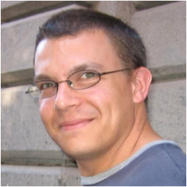
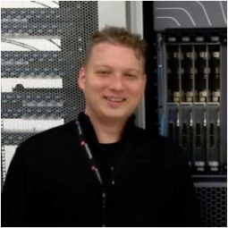
Presentation created by:
Greg Hankins
Nokia
greg.hankins@nokia.com
@greg_hankins
Job Snijders
NTT Communications
job@ntt.net
@JobSnijders
Reuse of this slide deck is permitted and encouraged!

Slide 44
Bonus slides

Slide 45
The Science Behind Shutting Down BGP Sessions
Avoiding disruptions during maintenance operations on BGP sessions: https://inl.info.ucl.ac.be/system/files/ucl-ft-bgp-shutdown-inl.pdf (August 2008)
Requirements for the Graceful Shutdown of BGP Sessions https://tools.ietf.org/html/rfc6198 (April 2011)

