Slide 1
TOP-IX
Interconnection services UPDATE
alessandro.galardini@top-ix.org
Nov 2017

Slide 2
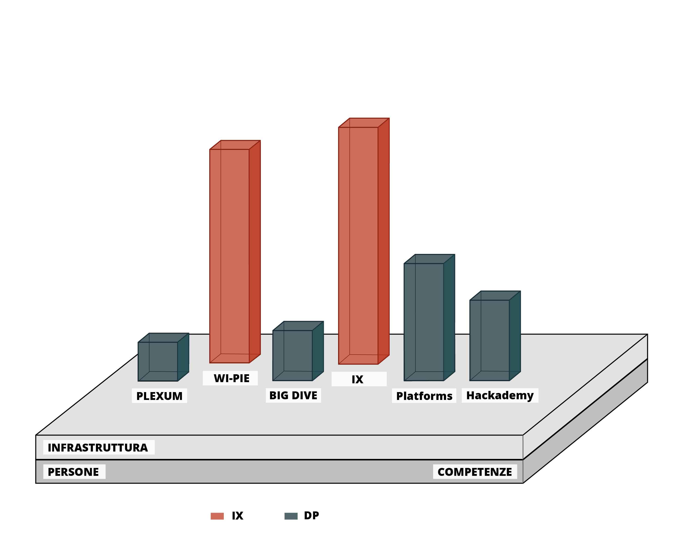
ACTIVITY MAP
INFRASTRUCTURE
PEOPLE
SKILLS

Slide 3
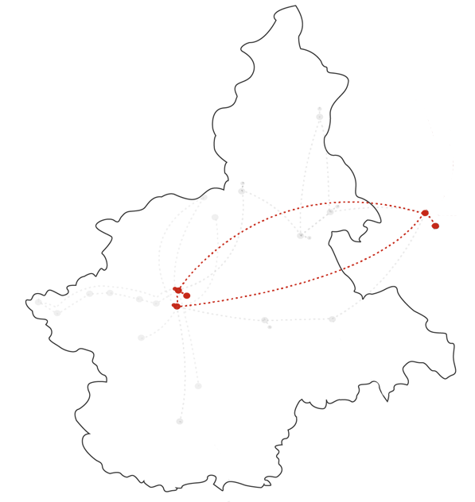
INTERNET EXCHANGE: infrastructure
5
PoPs
107
Connected Networks
46 K
IPv4 Prefixes on route servers
Milan
22 K
IPv6 Prefixes on route servers
89 Gbps
Peak traffic
Turin

Slide 4
INTERNET EXCHANGE: services
PUBLIC PEERING
PRIVATE CONNECTIONS (VLANs)
IP Transit
….
2 ROUTE SERVERS (BIRD)
F e J ROOT SERVERS

Slide 5
INTERCONNECTION: partnership
45 on 107 networks connected through different partnership

Slide 6
TECH UPDATE
100G available on TO PDF, TO CSI, MI Infracom
Secure Route Servers (4Q)
New management system (4Q)

Slide 7
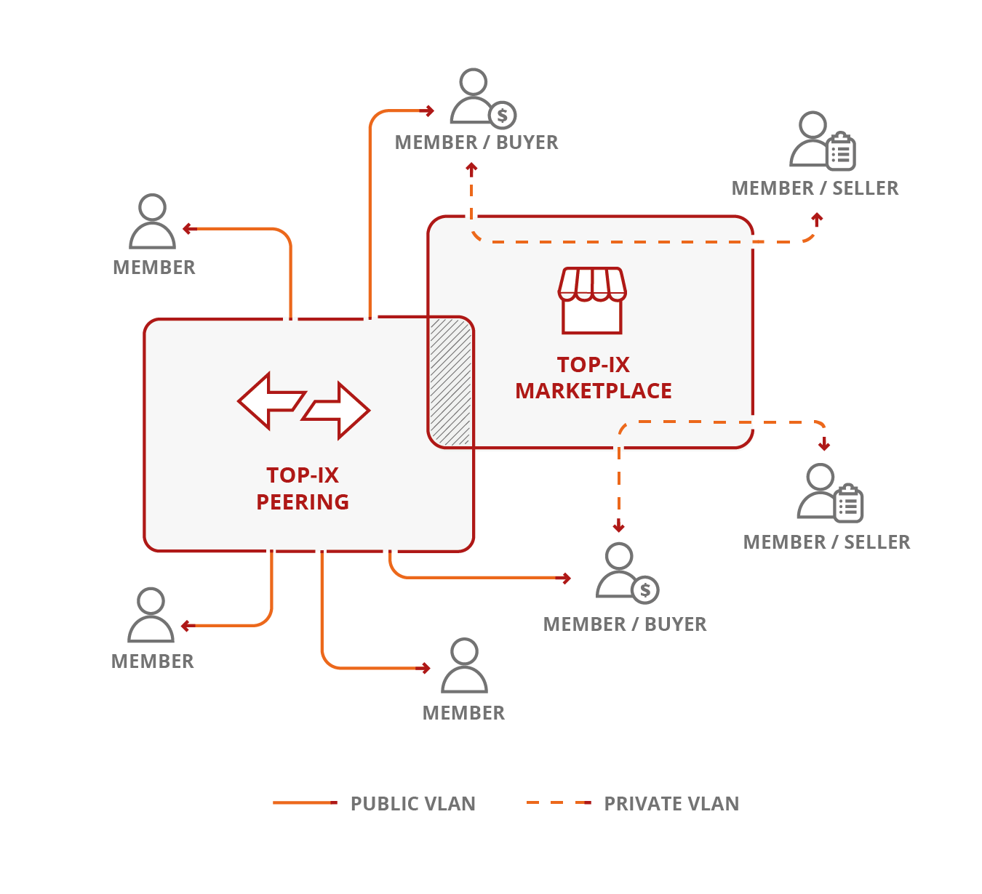
MARKETPLACE
End to End Ethernet connectivity
Access to public cloud
Remote Peering towards other IXP
Security services
…….

Slide 8
REMOTE ACCESS

Slide 9
CONTACTS
www.top-ix.org
mail: staff@top-ix.org
twitter: @top_ix
facebook: topixconsortium
linkedin: TOP-IX Consortium
youtube: topixtube

