Slide 1
Evolution of an Italian Access Network

Slide 2
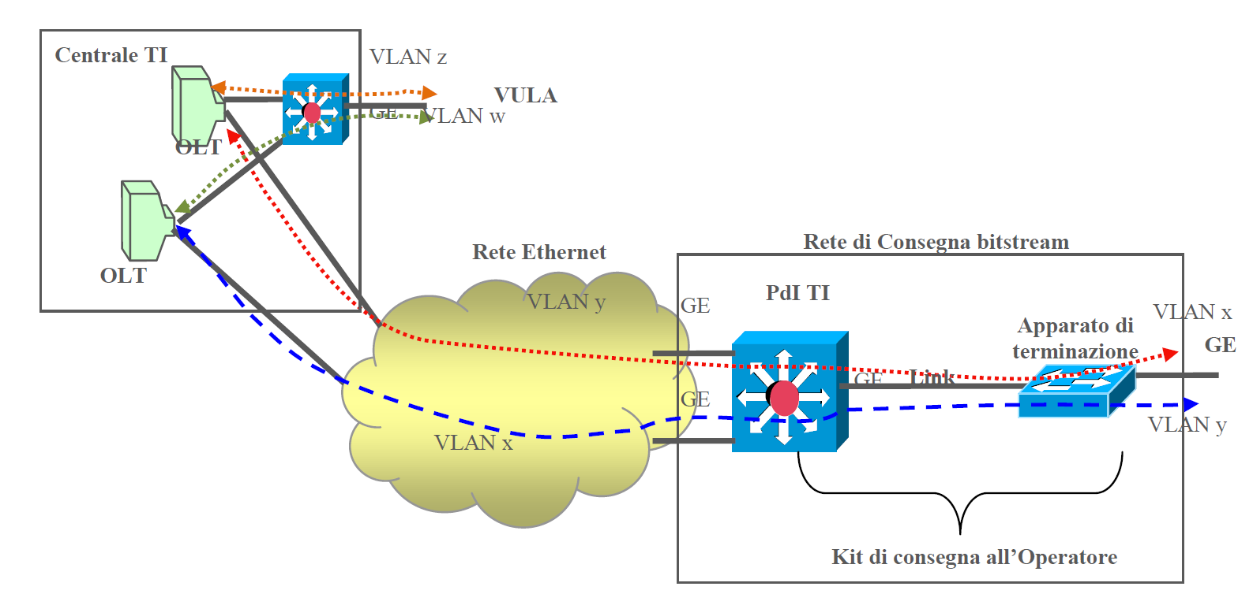
The Italian Model of Bitstream

Slide 3
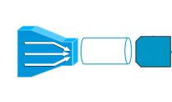
Bandwidth Italian Style
VLAN Group Cos 0
Bitstream ETH
VLAN Group Cos 1
Multiservice KIT
VLAN Group Cos 0
Raccolta NGA
VLAN Group Cos 1

Slide 4
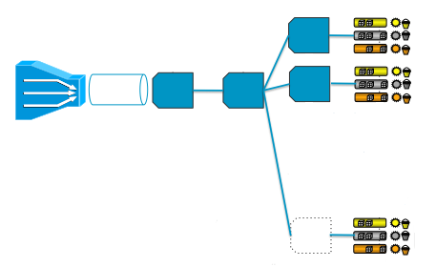
Qos model using ASR1k
PPPOE users
Area level
Shaper
Multiservice Kit
Subscriber
Parent class
Subscriber
Child class
Model ok with
single vlan
Not supported for
Group of
multiple vlans
Radius Provisioned

Slide 5
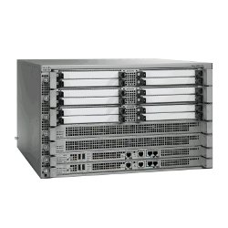
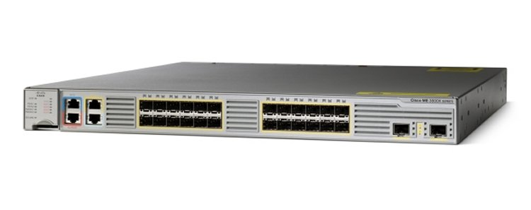
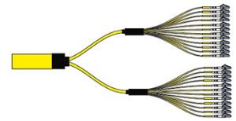
Work around for qos
1) Aggregate Vlans with vlan mapping all qos on asr
2) Apply area level shaping on ME/ASR aggregators
Subscriber level policies on ASR and color traffic

Slide 6
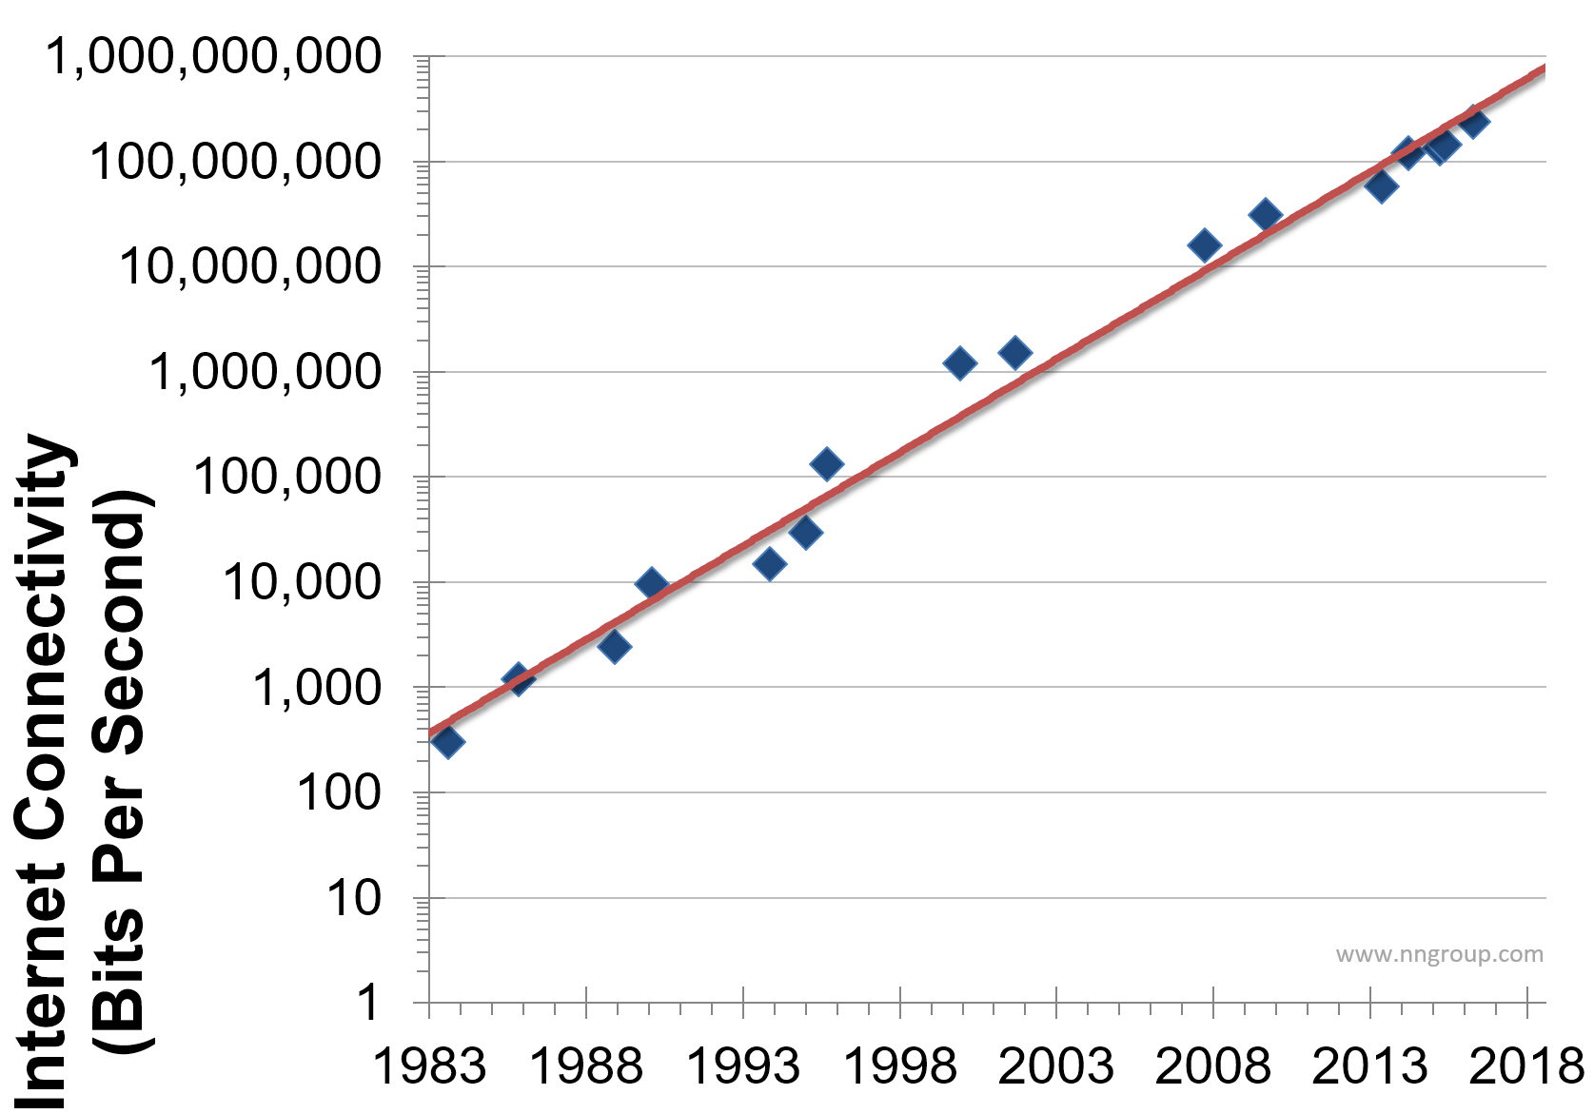
Need: migrate to 10G Kits
Nielsen's law of internet bandwidth states:
A high-end user's connection speed
grows by 50% per year.
AIIP Measurements
NGA consumes 3 times the mean bandwidth of ADSL users
FTTCAB 200Mbps
FTTH 1Gbps
Now available

Slide 7
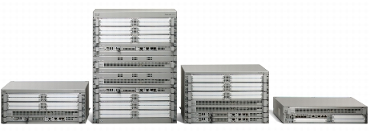
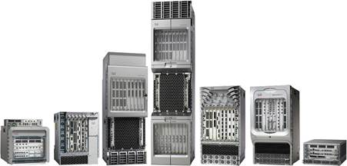
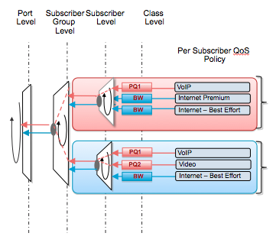
Choices
ASR9K
ASR1K
Well known
Low port density/high cost per port
EPA-10X10GE makes it more interesting but you need mip-100
Needs fan out device
Modern OS with XR
Higher scaling
Higher port density with lower per port costs. Satellites
Only one port with SPI? maybe

Slide 8
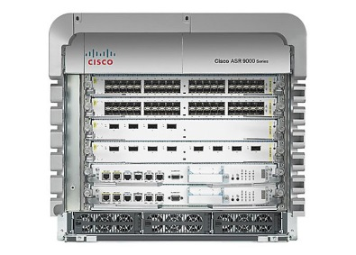
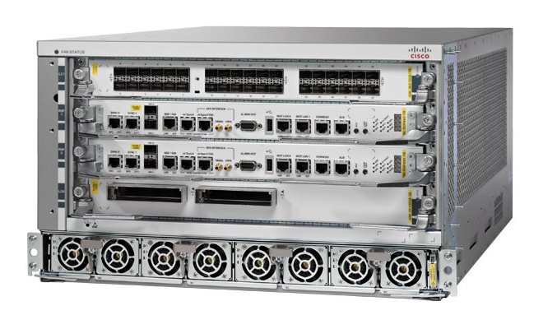
ASR 9k choices
Max 12 ports 10G
Can use Satellites
Typhoon based
So 32k subscribers per npu
Geo redundancy
Higher port densities
Can use satellites
Typhoon or Tomahawk
Up to 512k subscribers per chassis (future with xr 64 bit)
Processor redundancy nice for upgrades/switchovers for memory recuperation.
Geo redundancy

Slide 9
Typhoon or Tomahawk
 | Typhoon | Tomahawk
cpu | 32 bit Freescale PPC CPUs (P4040 4 cores @ 1.5Ghz) | 6-core Intel x86 64 bit CPUs (Ivy Bridge EN 6 cores @ 2Ghz)
layout | 60Gbps (~45Mpps) Full Duplex ASIC 60Gbps Skytrain Fabric Interconnect ASIC 220Gbps Sacramento Fabric Switching ASIC | 240Gbps Full Duplex ASIC 200Gbps Tigershark Fabric Interconnect ASIC 1.20Tbps SM15 Fabric Switching ASIC
buffer | 2GB of packet buffers (~100ms) | 12GB of packet buffers (~200ms)
EFP | 64k/LC | 256k/LC
L3 sub int | 20k/LC | 128k/LC
egress queue | 256k/npu | 1M/npu
Subscribers | 32k/npu 192k/chassis | 64k/npu 512k/chassis
Typhoon and 4 chunks.?.?.
So 32k shapers = 4 chunks of 8k
Each chunk is assigned to interface/sub
So need 4 int/subs to get 32k per npu
Some Tomahawk scale indicated requires 64bit ios XR

Slide 10
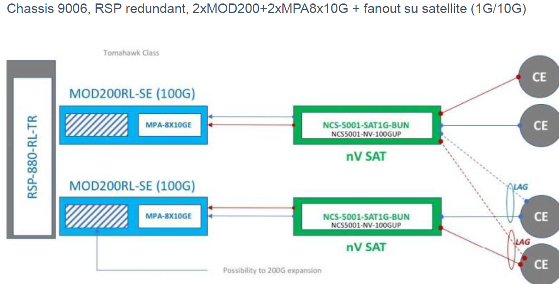
Our choice something future proof
“now one crux is that when we state evolved XR, this means that you need a tomahawk and RSP880 chassis. this is not a sales trick, but evolved XR runs 64bit and virtual machines. the typhoon LC is based on PPC and 32 bit. virtualization on ppc is not commercially available, hence typhoon won't run evolved XR, although we prototyped 32<>64 bit interaction.”
Xander Thuijs
https://supportforums.cisco.com/t5/xr-os-and-platforms/limit-of-bng-subscribers-in-asr-9000/td-p/3021765

