Slide 1
1 Year of the ITNOG on the road experience Flavio Luciani – NAMEX Alessandro Galardini – TOP-IX

Slide 2
ITNOG on the road
In order to promote the growth of the Internet community in Italy, ITNOG is launching a series of events under the brand ITNOG On The Road
The aim of this program is to kick start local communities around Italy to promote a tighter cooperation between network operators
Open initiative: everyone can sign an agreement with ITNOG association under a ITNOG Partnership Program:
Formalize the relationship with the OTR hosts
Allow the OTR hosts to leverage the ITNOG brand in autonomy
The event format is left to the event’s host

Slide 3
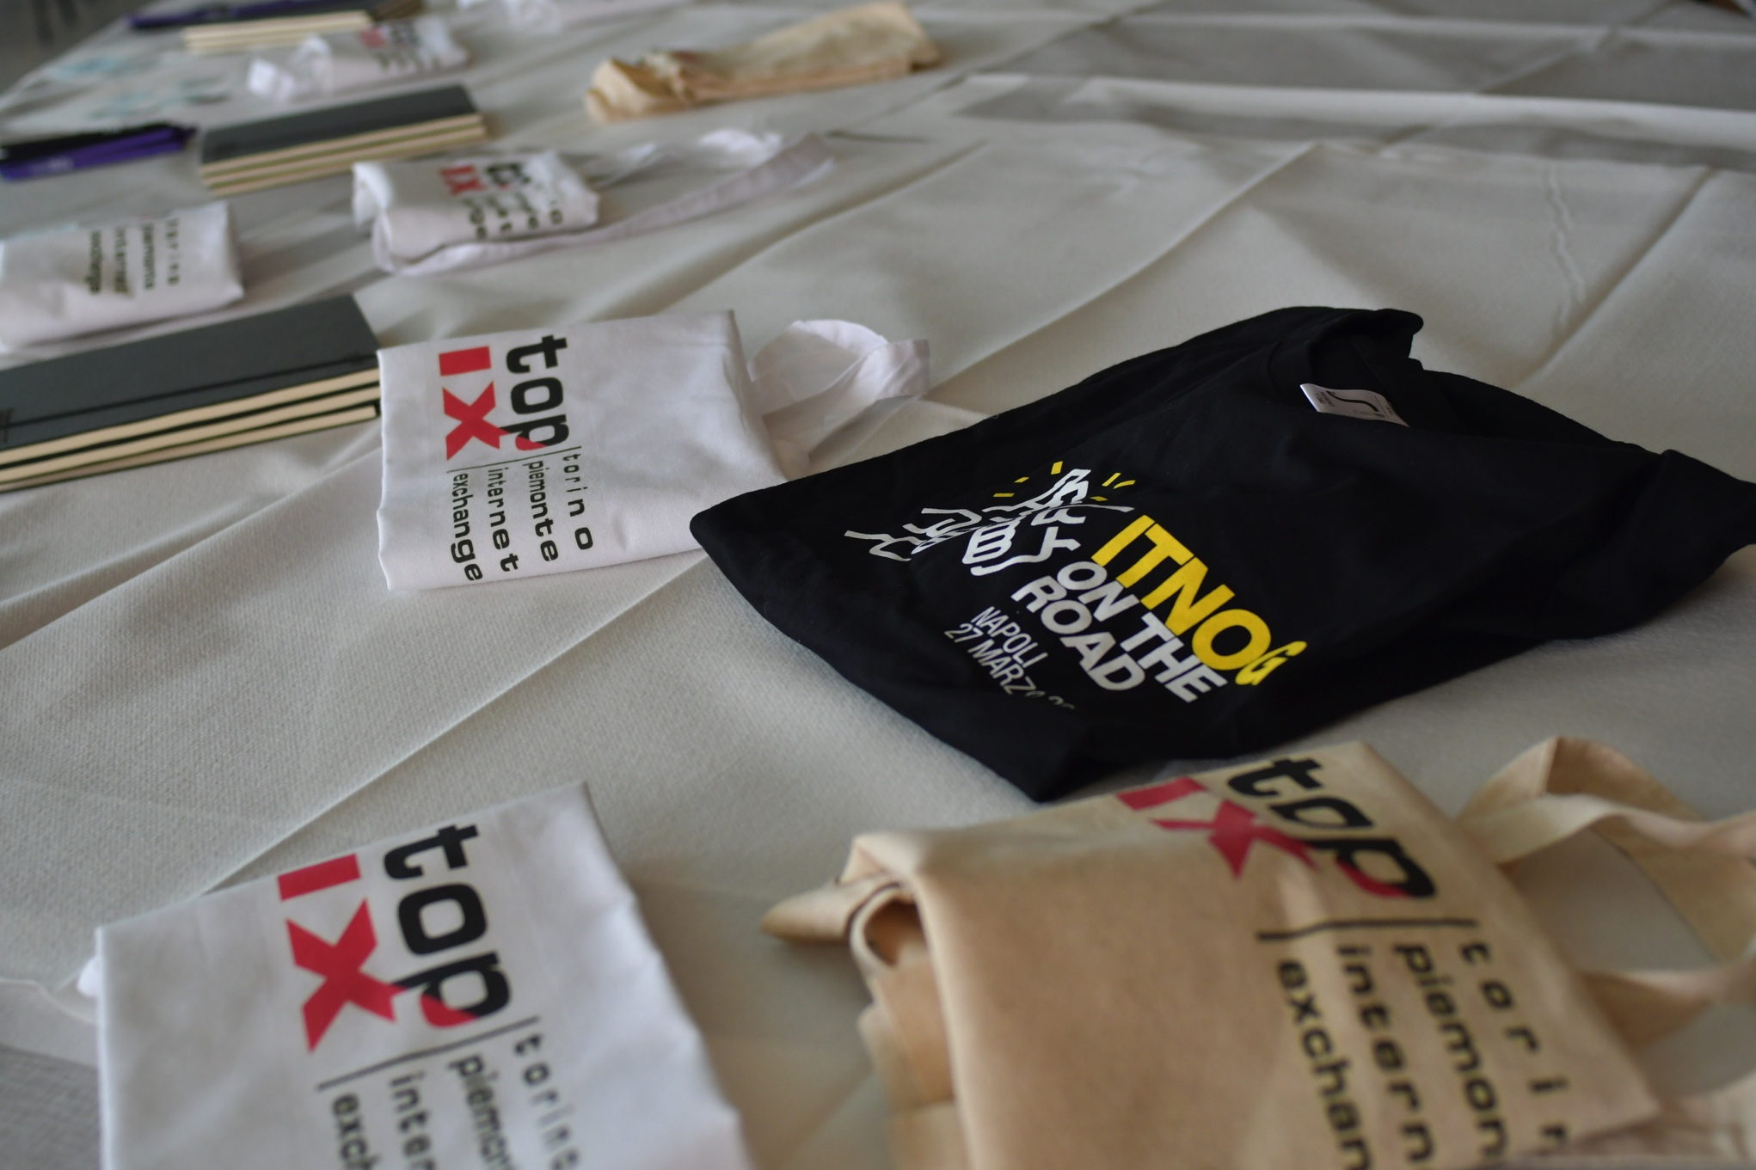
TARGET/FORMAT
Small/Medium sized ISPs
needs: IXPs services / RIPE NCC requests / BGP insights
Small events in order to facilitate the interaction between local ISPs and us
A learning session in the afternoon (in Italian)
Topics:
RIPE NCC services
Peering 101: an insight into the IXPs world
BGP protocol: an introduction and live session
BGP: basic security practices
BGP community
Gadget: T-shirt / BGP book (by Tiziano Tofoni)
A social event with different formula:
Aperitif (Roma and Torino)
Dinner (Pescara and Napoli)

Slide 4
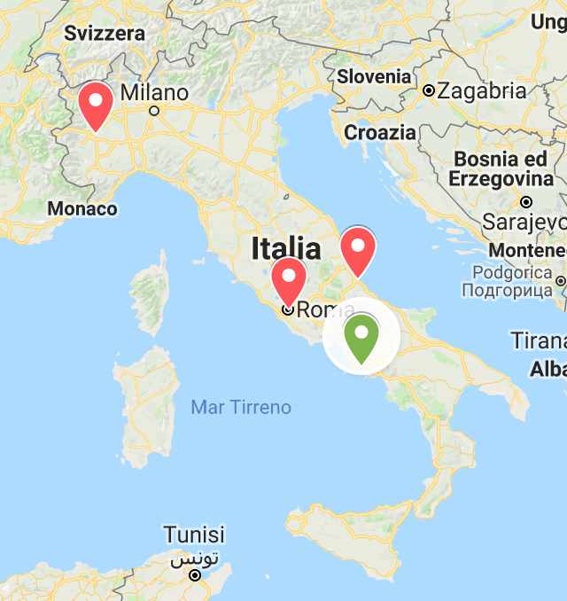
A journey around Italy
Città | Data
Roma | 10/07/2018
Torino | 25/09/2018
Pescara | 12/12/2018
Napoli | 27/03/2019

Slide 5
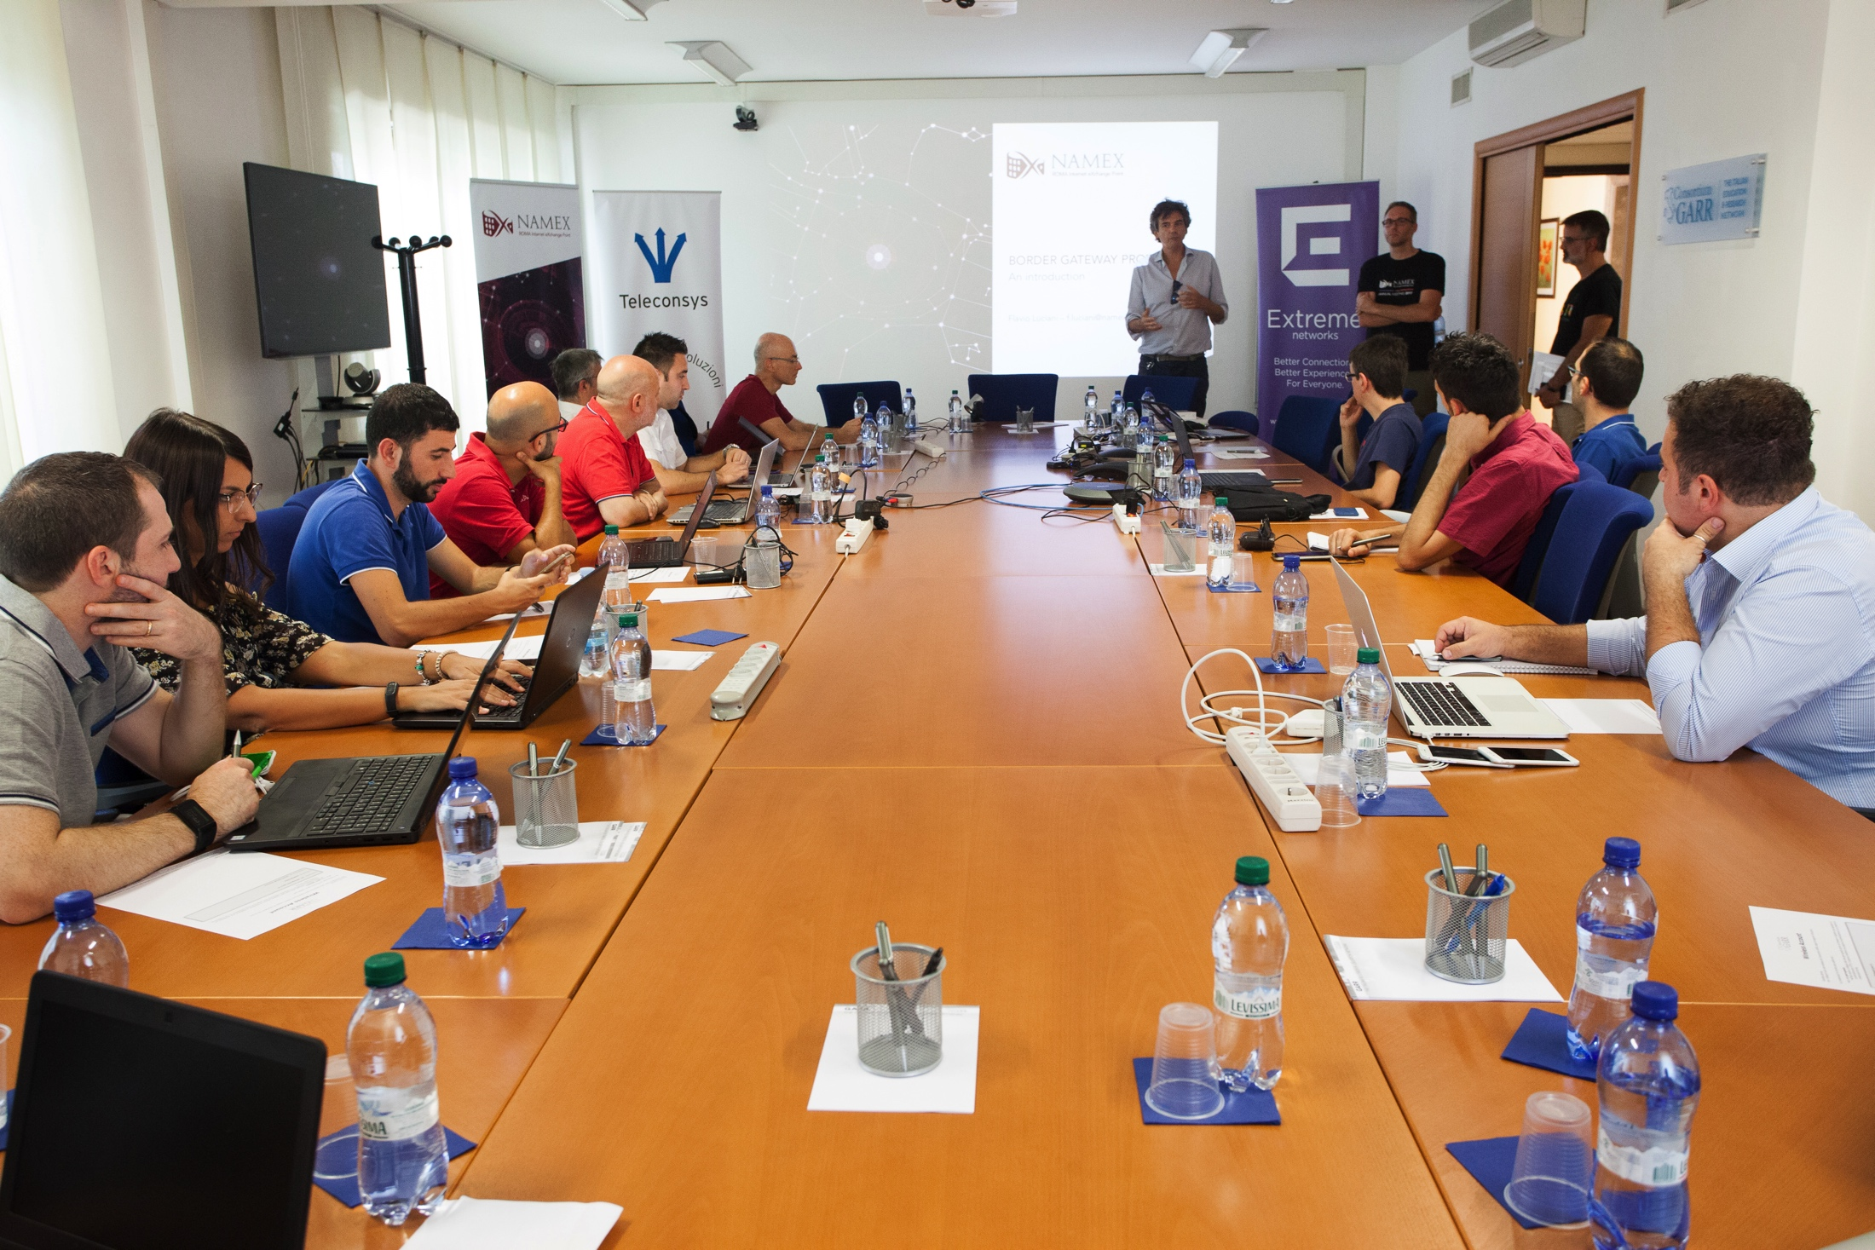
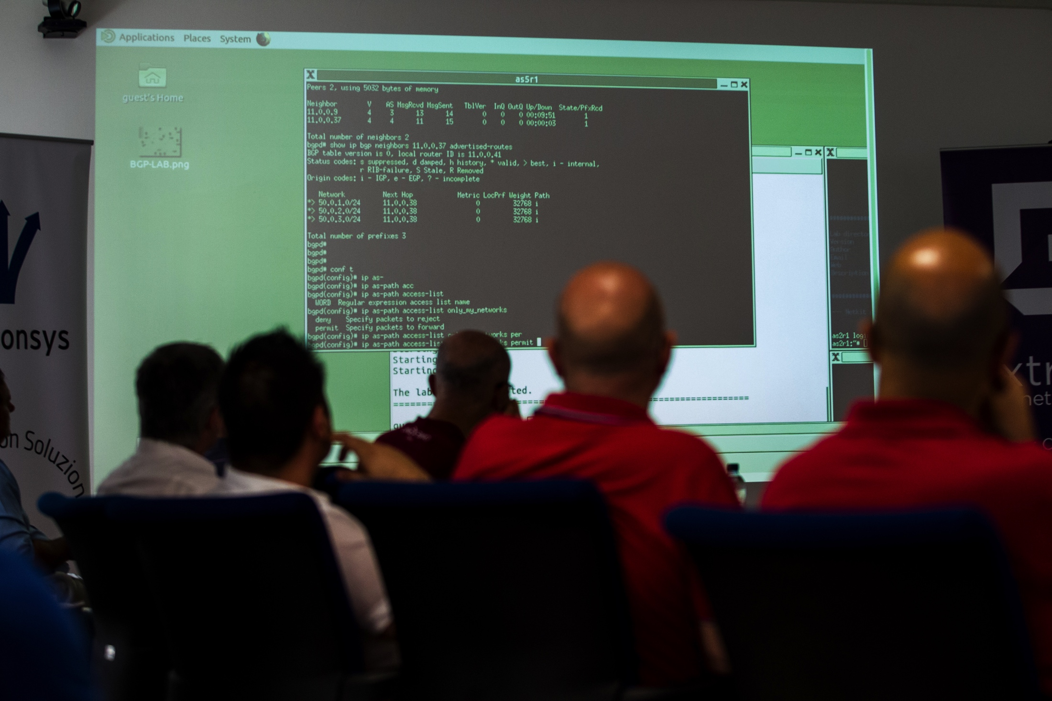
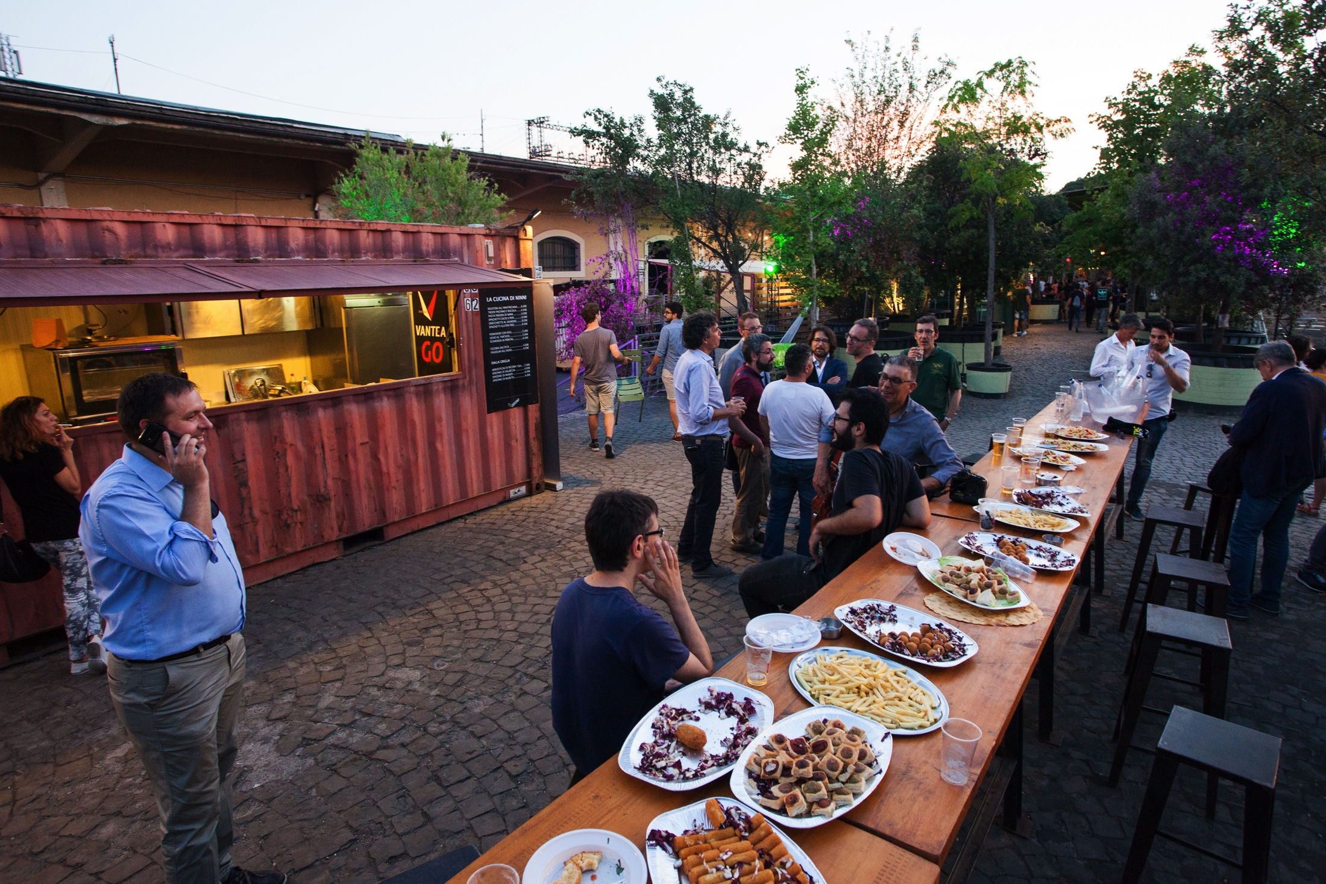
Roma – 10/07/2018
City | #attendees | #ISPs | #sponsor
Roma | 45 | 13 | 1

Slide 6
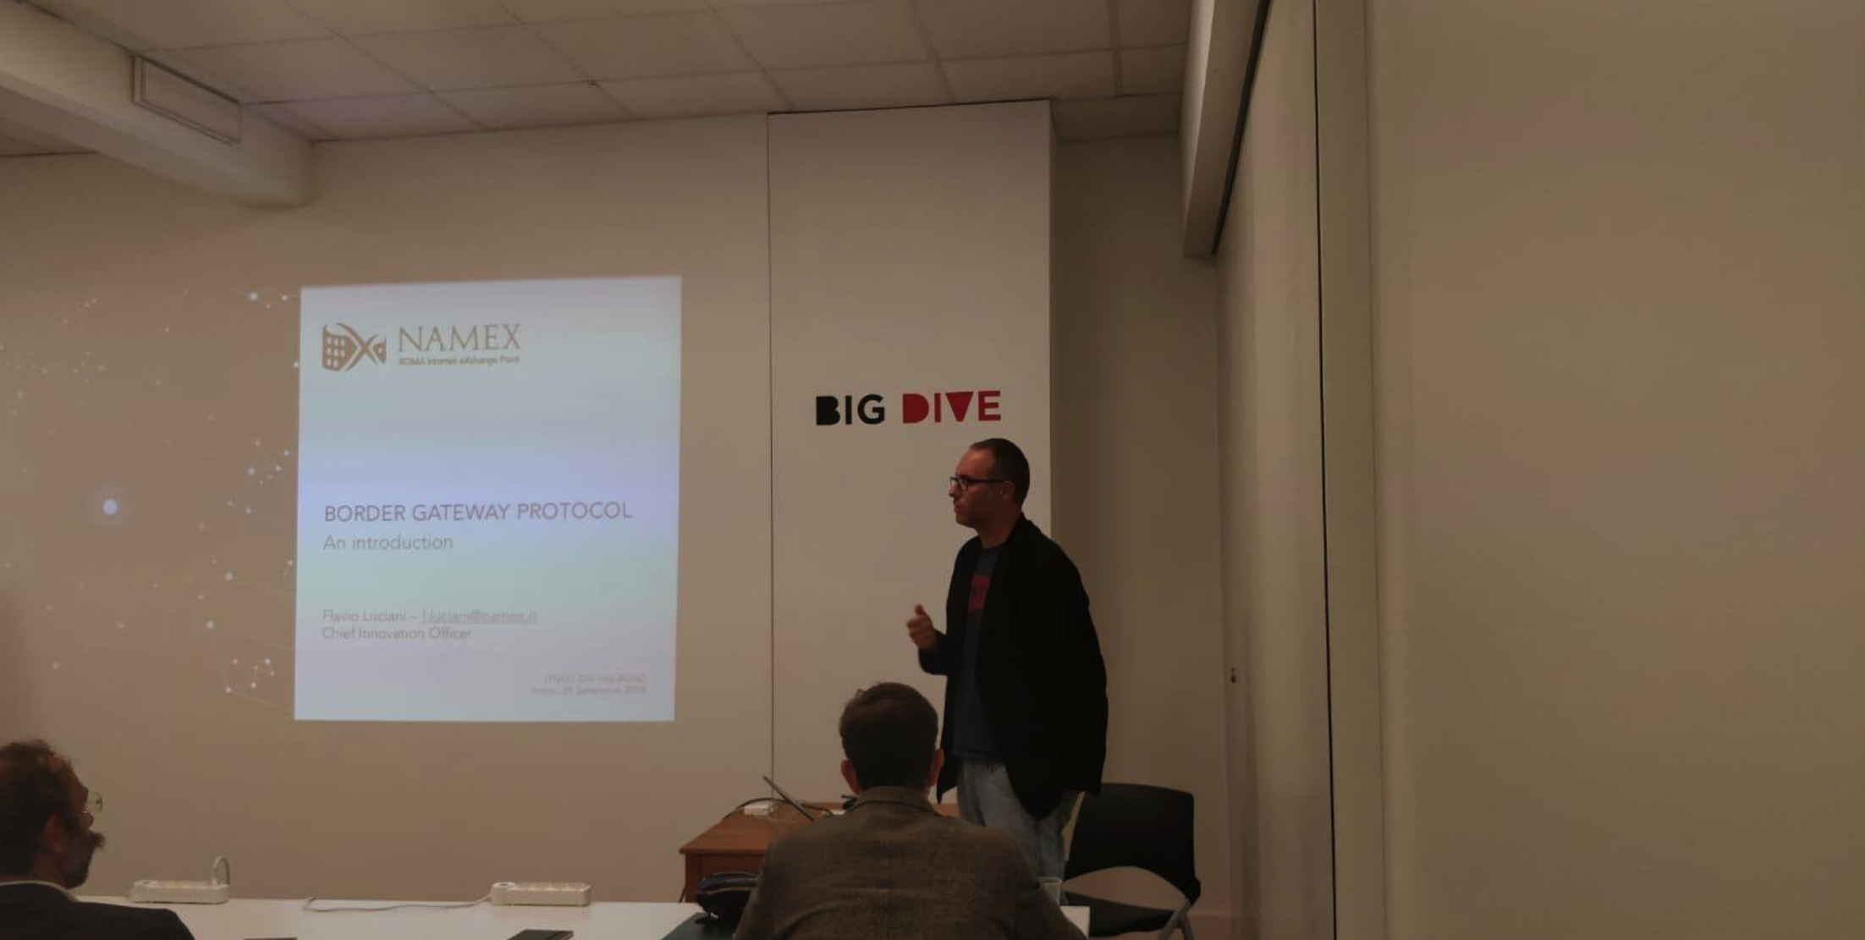
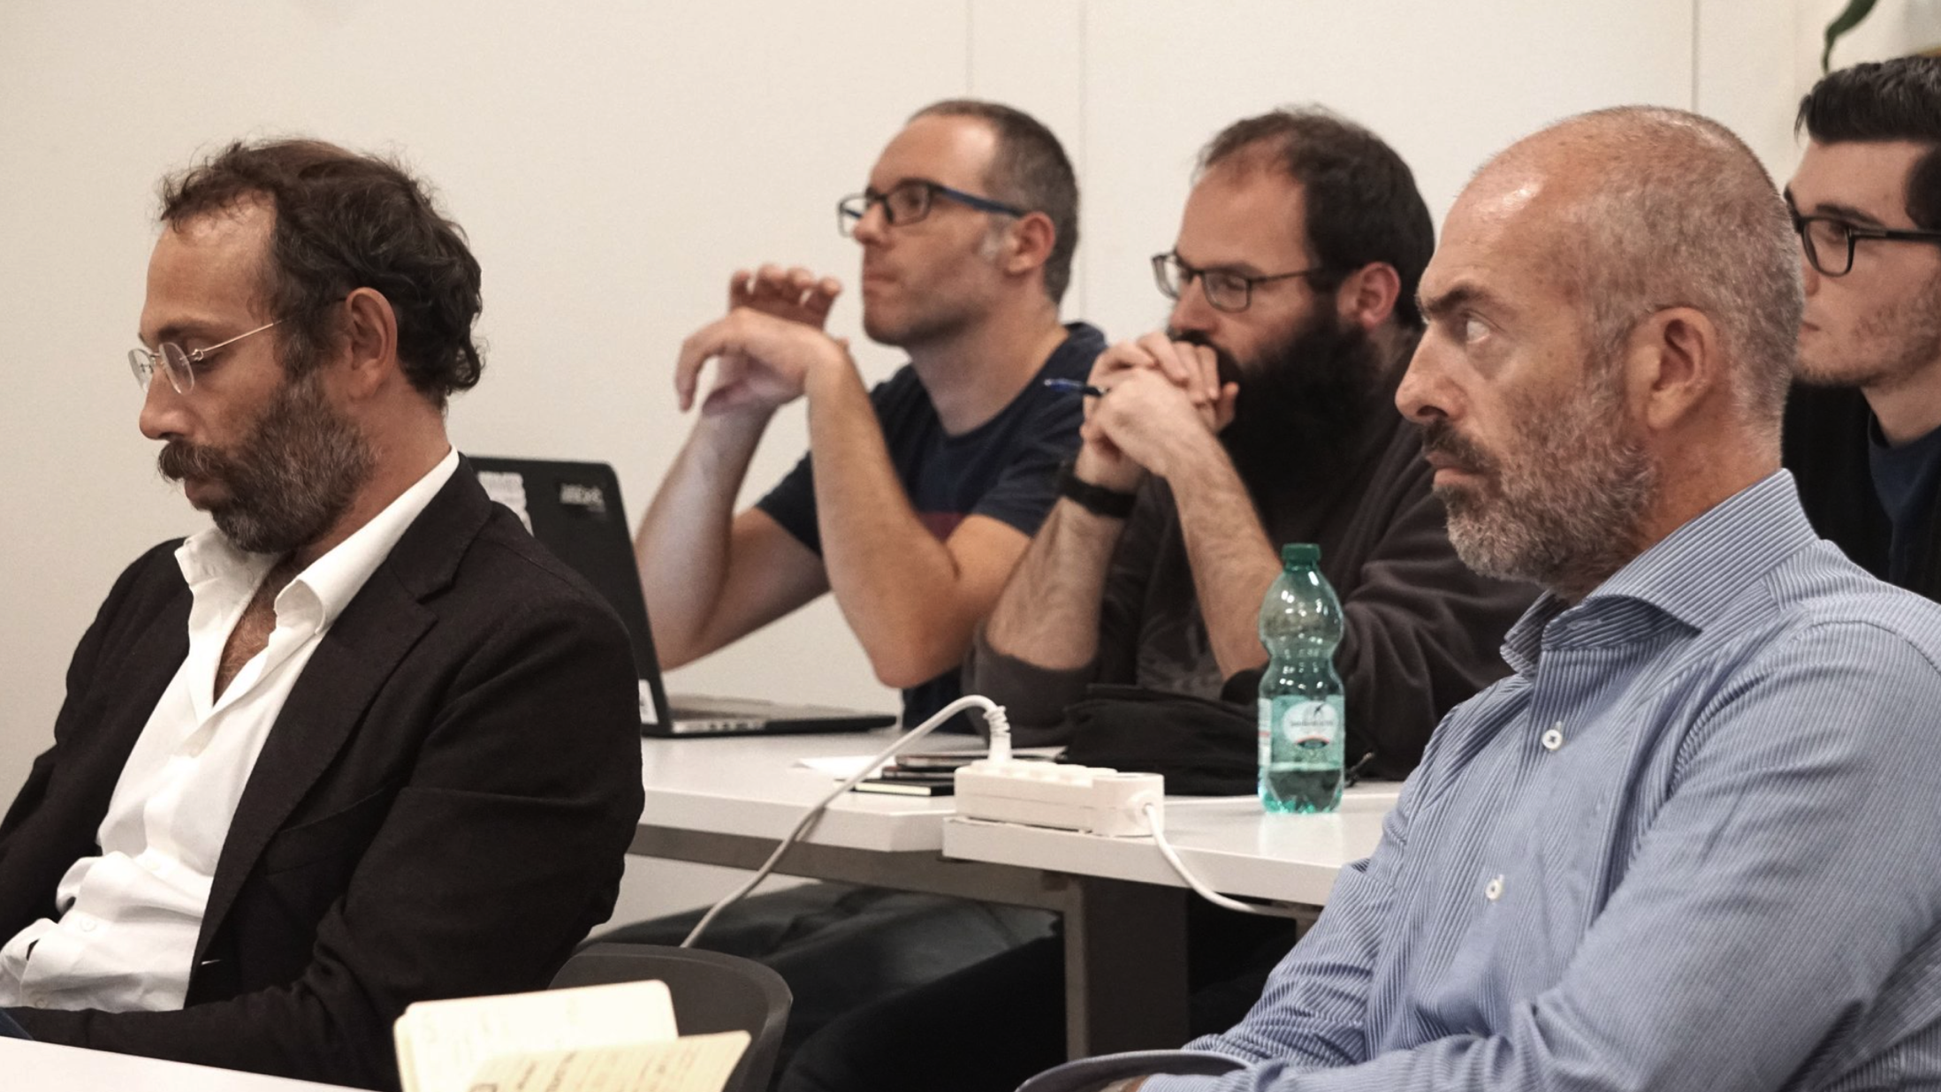
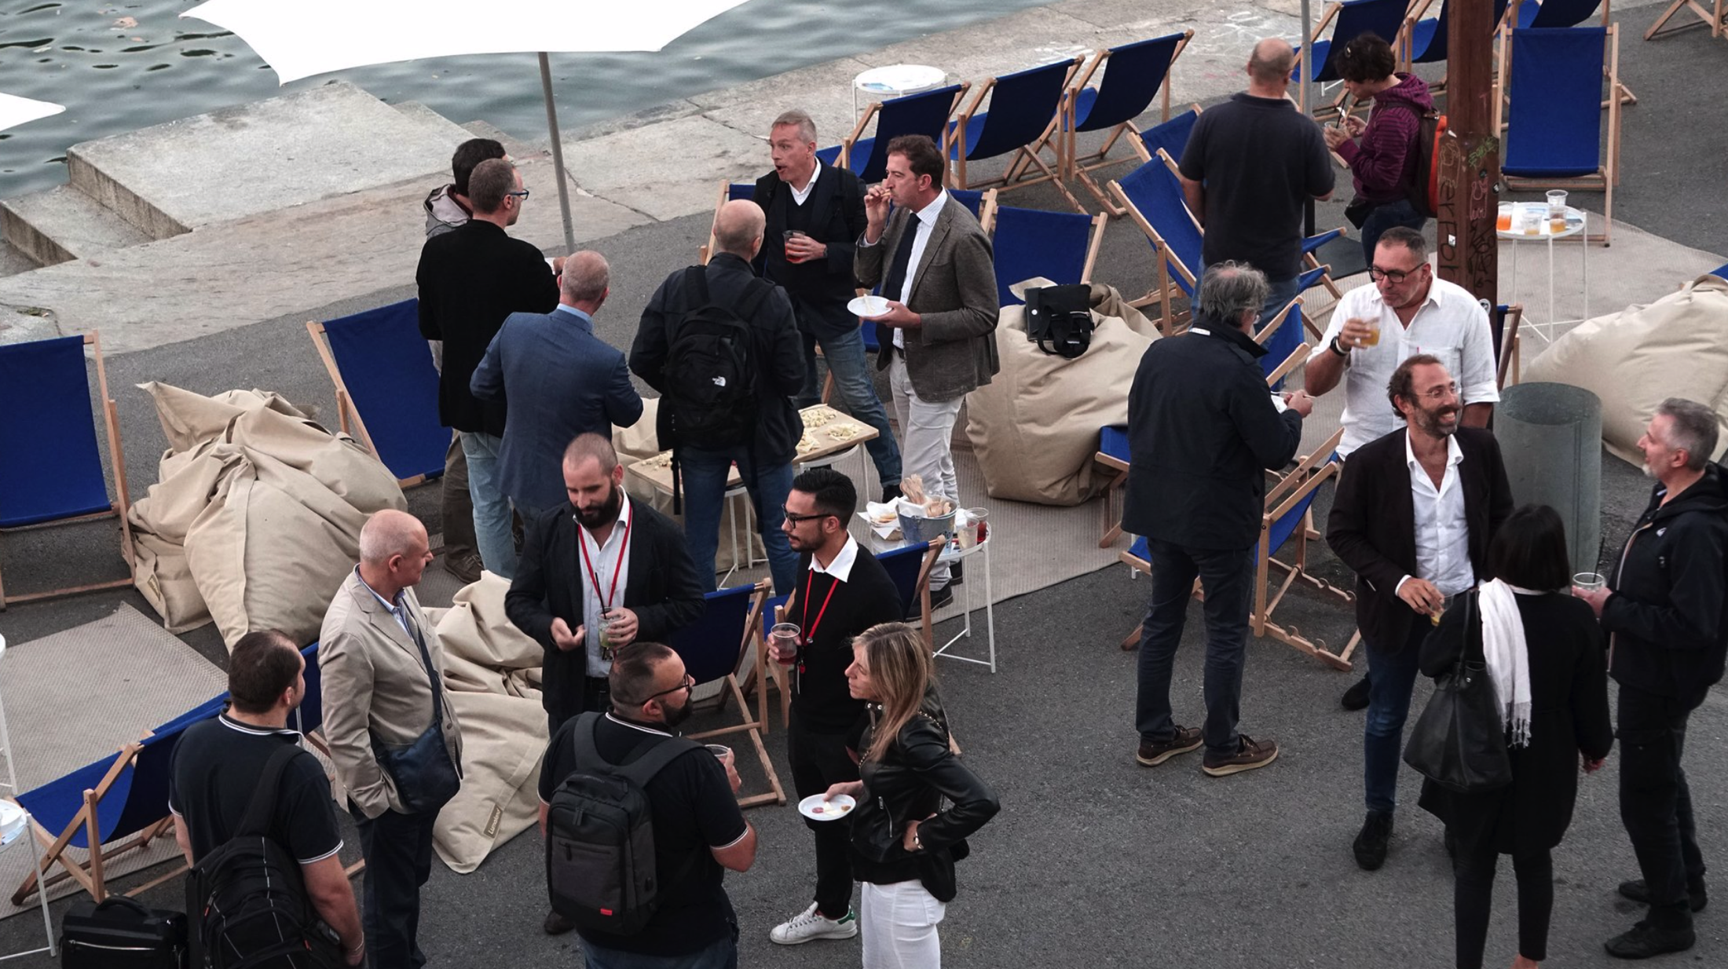
Torino – 25/09/2018
City | #attendees | #ISPs | #sponsor
Torino | 35 | 9 | 0

Slide 7
Pescara – 12/12/2018
City | #attendees | #ISPs | #sponsor
Pescara | 29 | 11 | 1

Slide 8
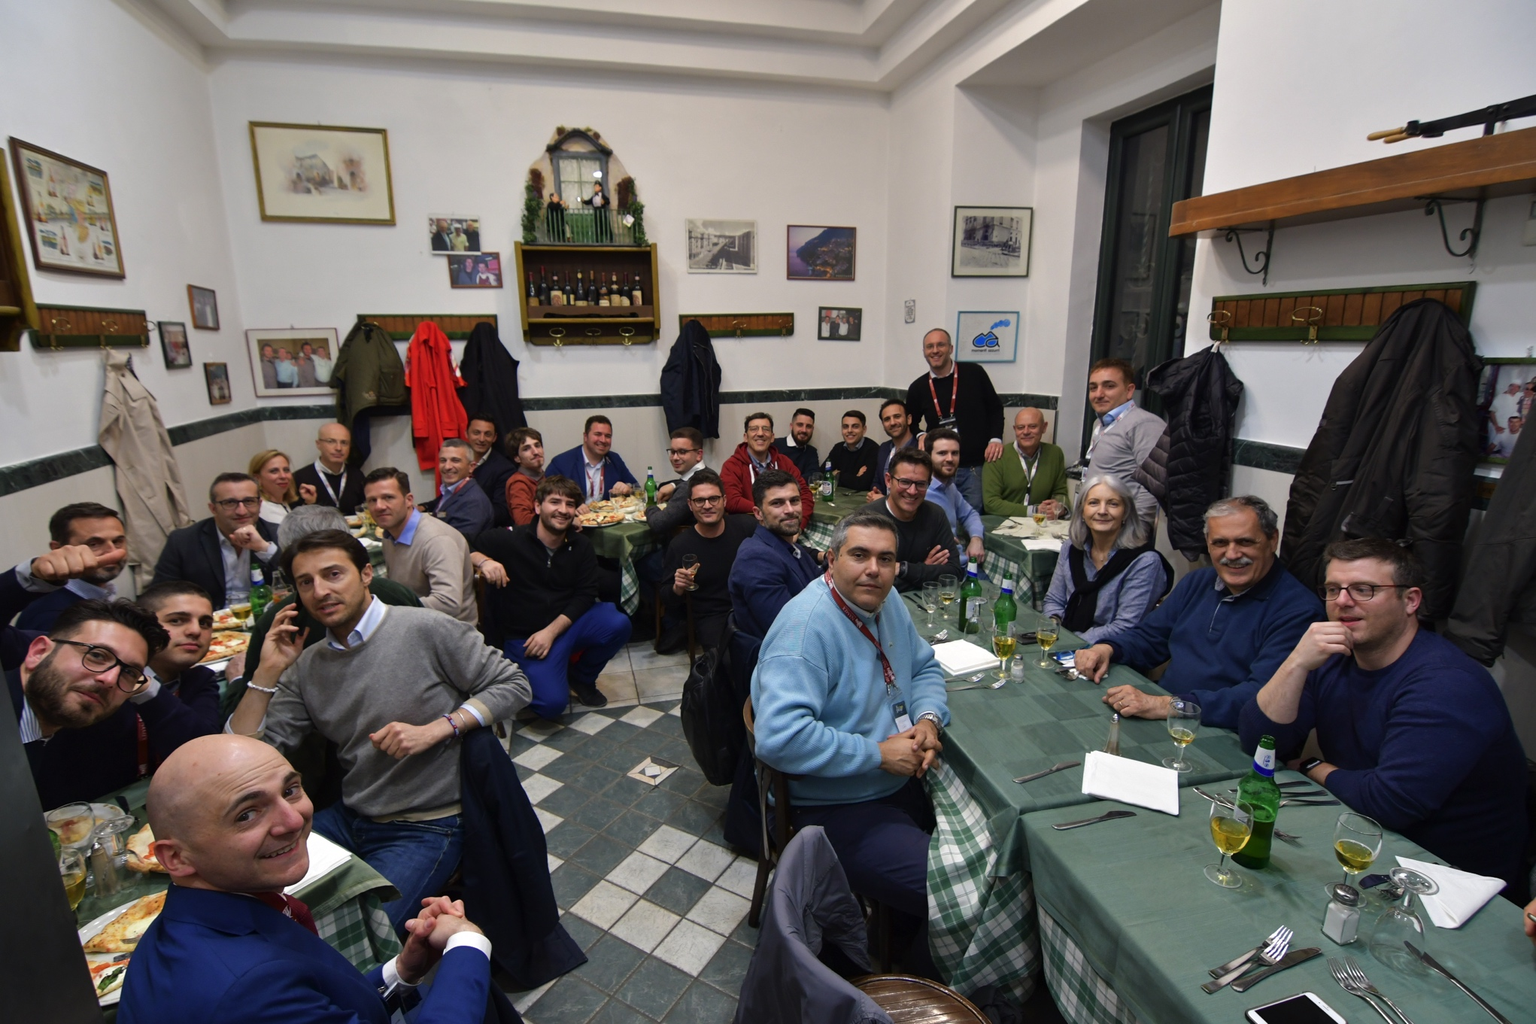
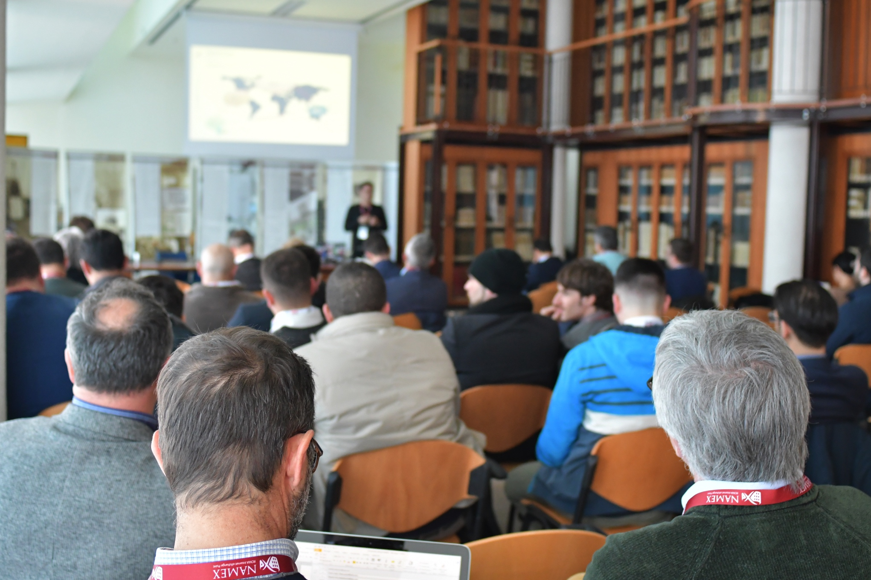
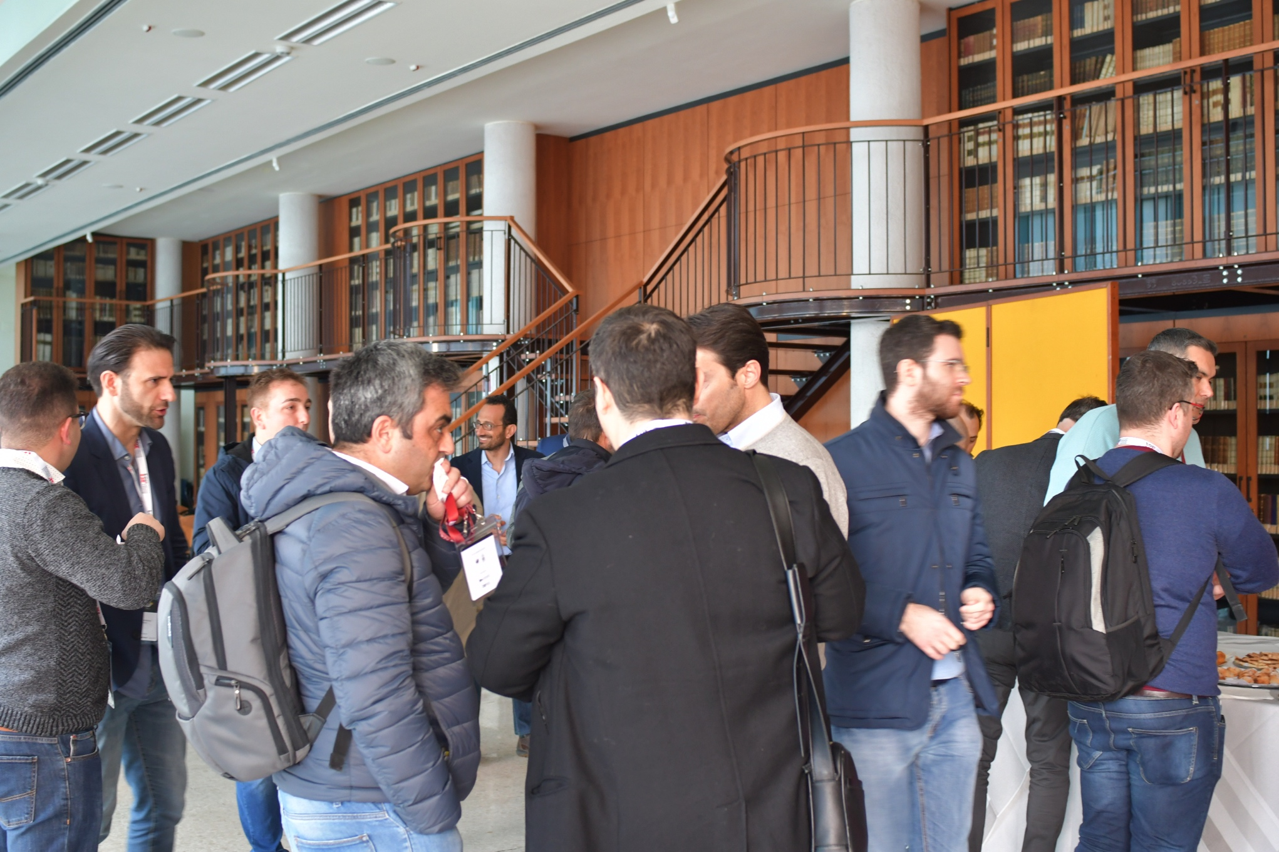
Napoli– 27/03/2019
City | #attendees | #ISPs | #sponsor
Napoli | 50 | 25 | 3

Slide 9
NUMBERS
City | #attendees | #ISPs | #sponsor
Roma | 45 | 13 | 1
Torino | 35 | 9 | 0
Pescara | 29 | 11 | 1
Napoli | 50 | 25 | 3
 | 159 | 58

Slide 10
THANKS – flavio.luciani@namex.it
alessandro.galardini@top-ix.org
QUESTIONS?

