Slide 1
IXPDB & Euro-IX Tools
ITNOG5 2019, Bologna
Bijal Sanghani

Slide 2
Euro-IX - Association of IXPs
73 affiliated members
54 IXPs in the Euro-IX region, 49 countries, operating over 100 peering LANs
19 IXPs from the rest of the world
Newest Member:
  DO-IX - Dortmund Internet Exchange
  ANIX – Albanian Internet Exchange

Slide 3










Euro-IX Patrons

Slide 4
Euro-IX Activities
2 Fora a year
  33rd in Venice hosted by NAMEX, TOP-IX and VSIX (November 2018)
  34th in Toulouse hosted by TOUIX and France-IX
Website & Database
Fellowship & Mentor-IX Programs
Reports – Benchmarking, traffic, hardware, route servers.
Newsletters - https://www.euro-ix.net/en/communications/newsletters/
Route Server Large BGP communities list: https://www.euro-ix.net/en/forixps/large-bgp-communities/
Social media
  Twitter @euroix
  Facebook fb.me/maineuroix
  Youtube youtube.com/channel/UCFyucVRAAMzxyJIsxnGwsjw

Slide 5
IX-F, IXPDB & Tools

Slide 6
Intro - IX-F Internet eXchange Federation
AFIX
Kyle Spencer – UIXP
Nishal Goburdhan – JINX
APIX
Katsuyasu Toyama – JPNAP
Tom Paseka – NZIX
Euro-IX
Andy Davidson – Asteroid
Ondrej Fillip – NIX.CZ
LAC-IX
Milton Kashiwakura – IX.br
Ariel Graizer – NAP CABASE

Slide 7
IXPDB - Some History
Not new, the original code was written around 15 years ago…
Membership feedback from consultations and Survey clearly showed IXPs wanted a place to publish an accurate and complete data set.
As members of IX-F it didn’t make sense for all of us to create individual regional databases or directories
In 2016 we considered the limitations of the underlying database and structure.
We wanted to move forward with automation and work started on the IXP Member List JSON Schema, which is now also used in PeeringDB
In 2017 we contracted the website and IXP Database work to CZ.NIC.

Slide 8

What we’ve been working on..
You can access the IXPDB via https://ixpdb.euro-ix.net/

Slide 9
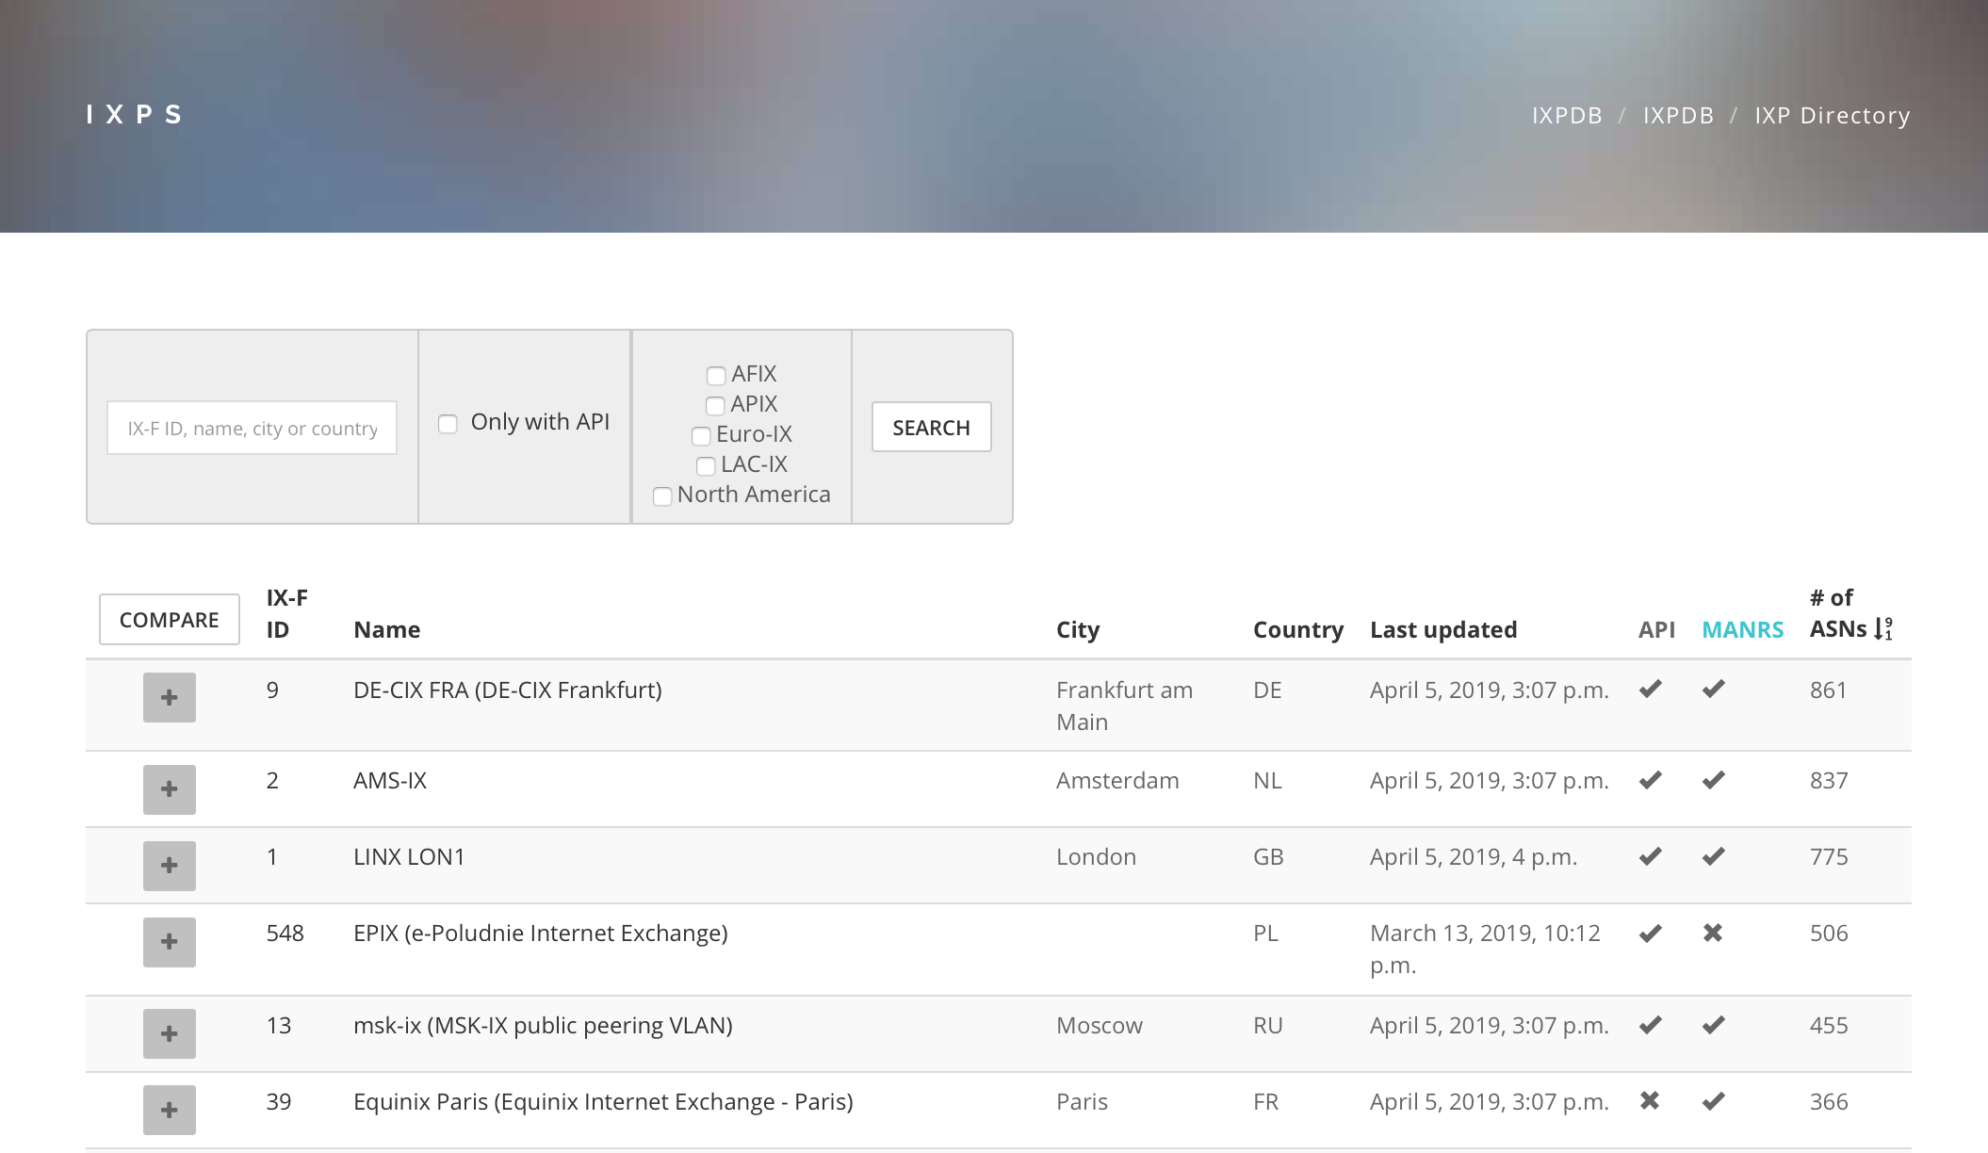
What we’ve been working on – IXP Directory

Slide 10
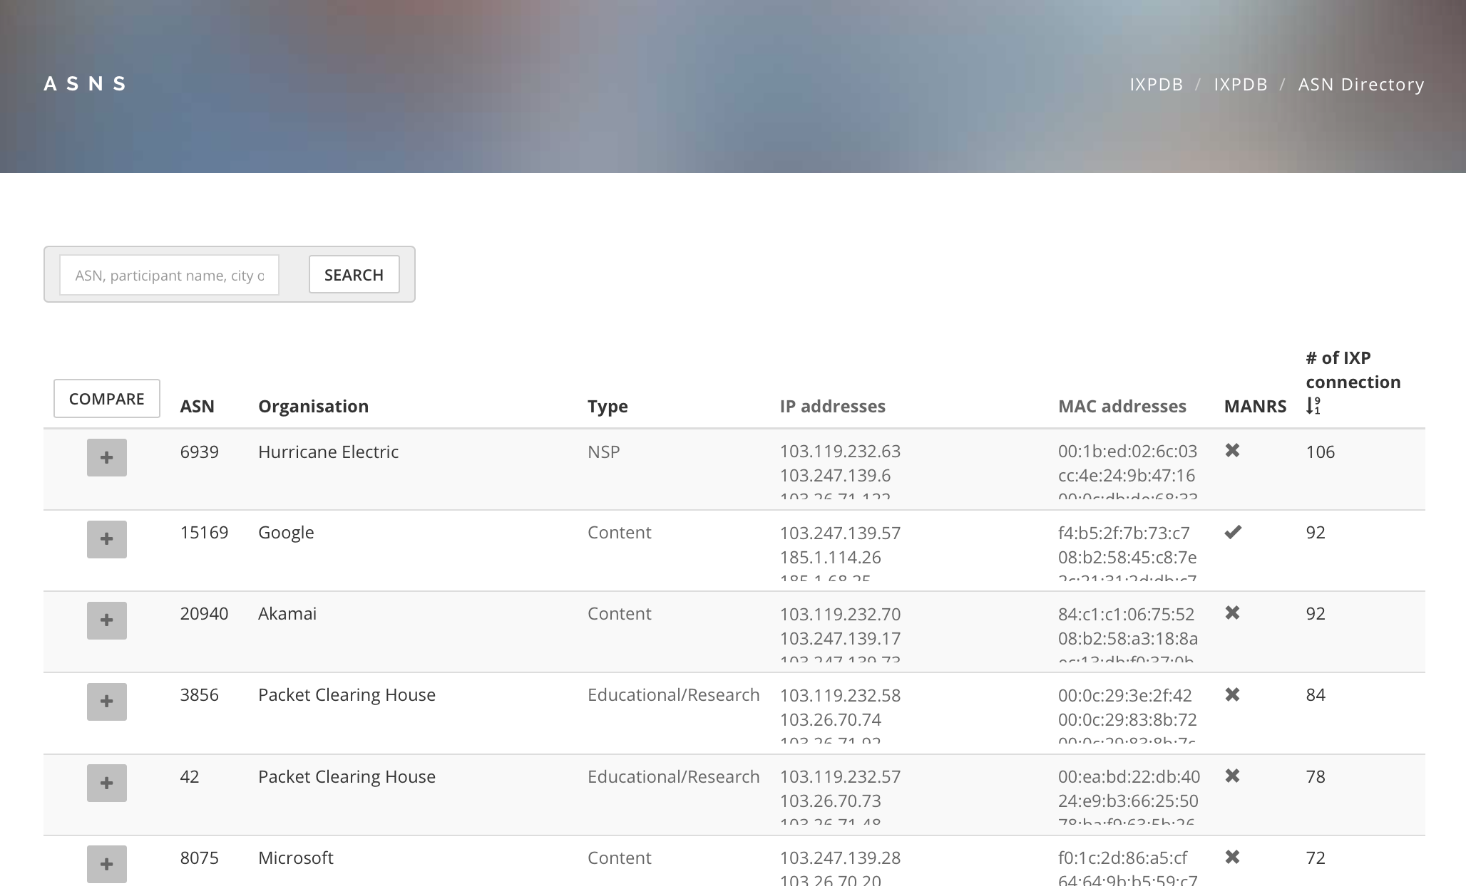
What we’ve been working on – ASN Directory
https://ixpdb.euro-ix.net/en/ixpdb/asns/

Slide 11
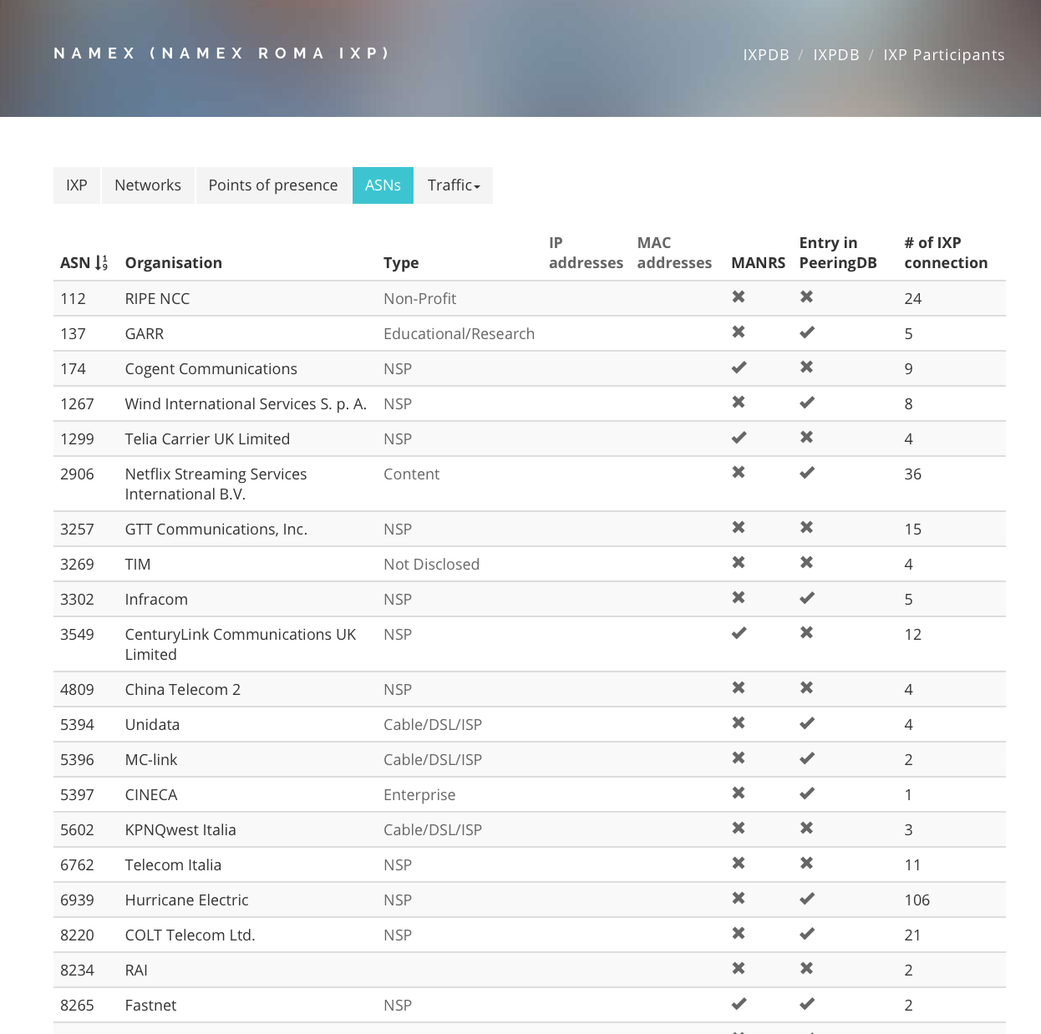
What we’ve been working on – IXP Member List

Slide 12
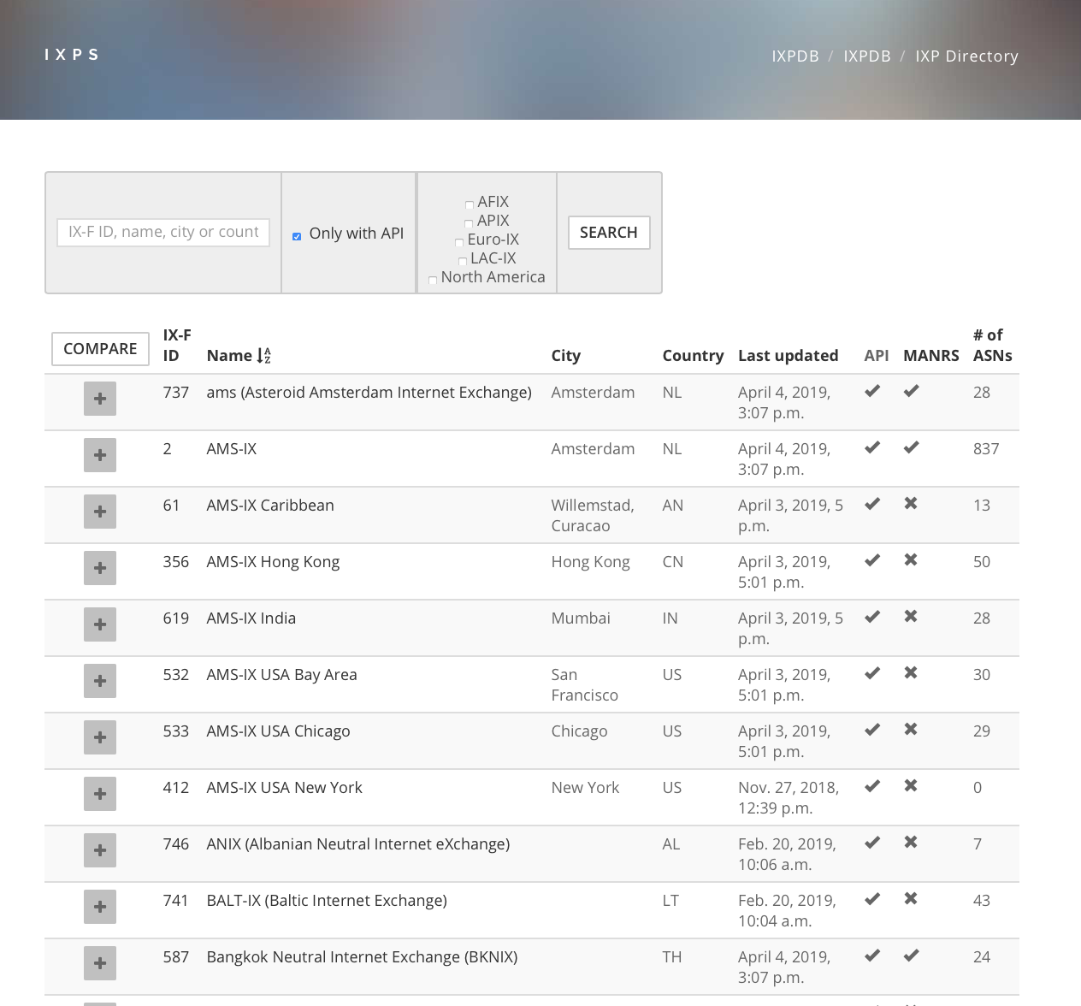
What we’ve been working on – Compare IXPs

Slide 13
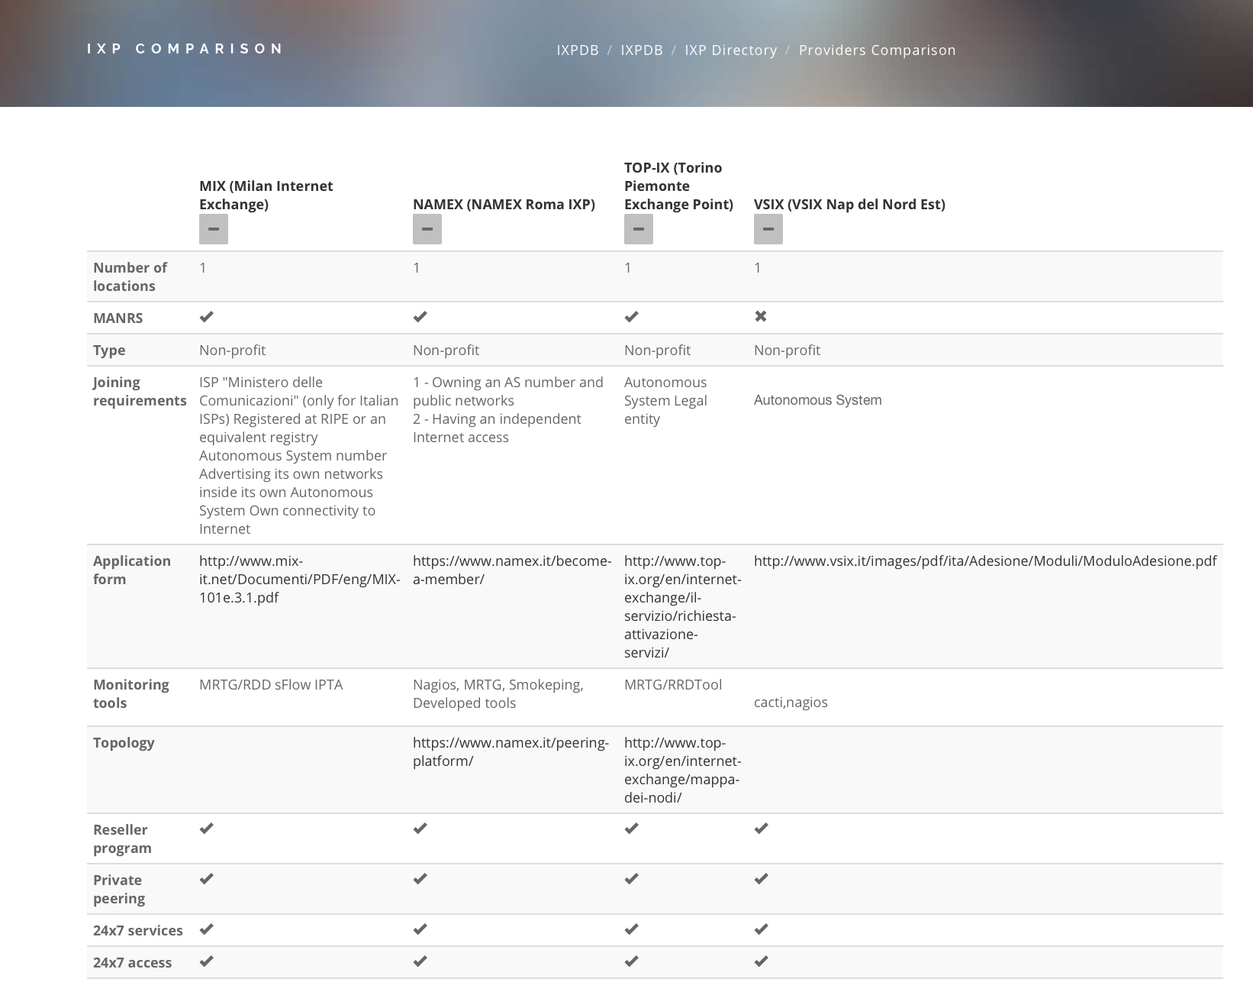
What we’ve been working on – Compare IXPs

Slide 14
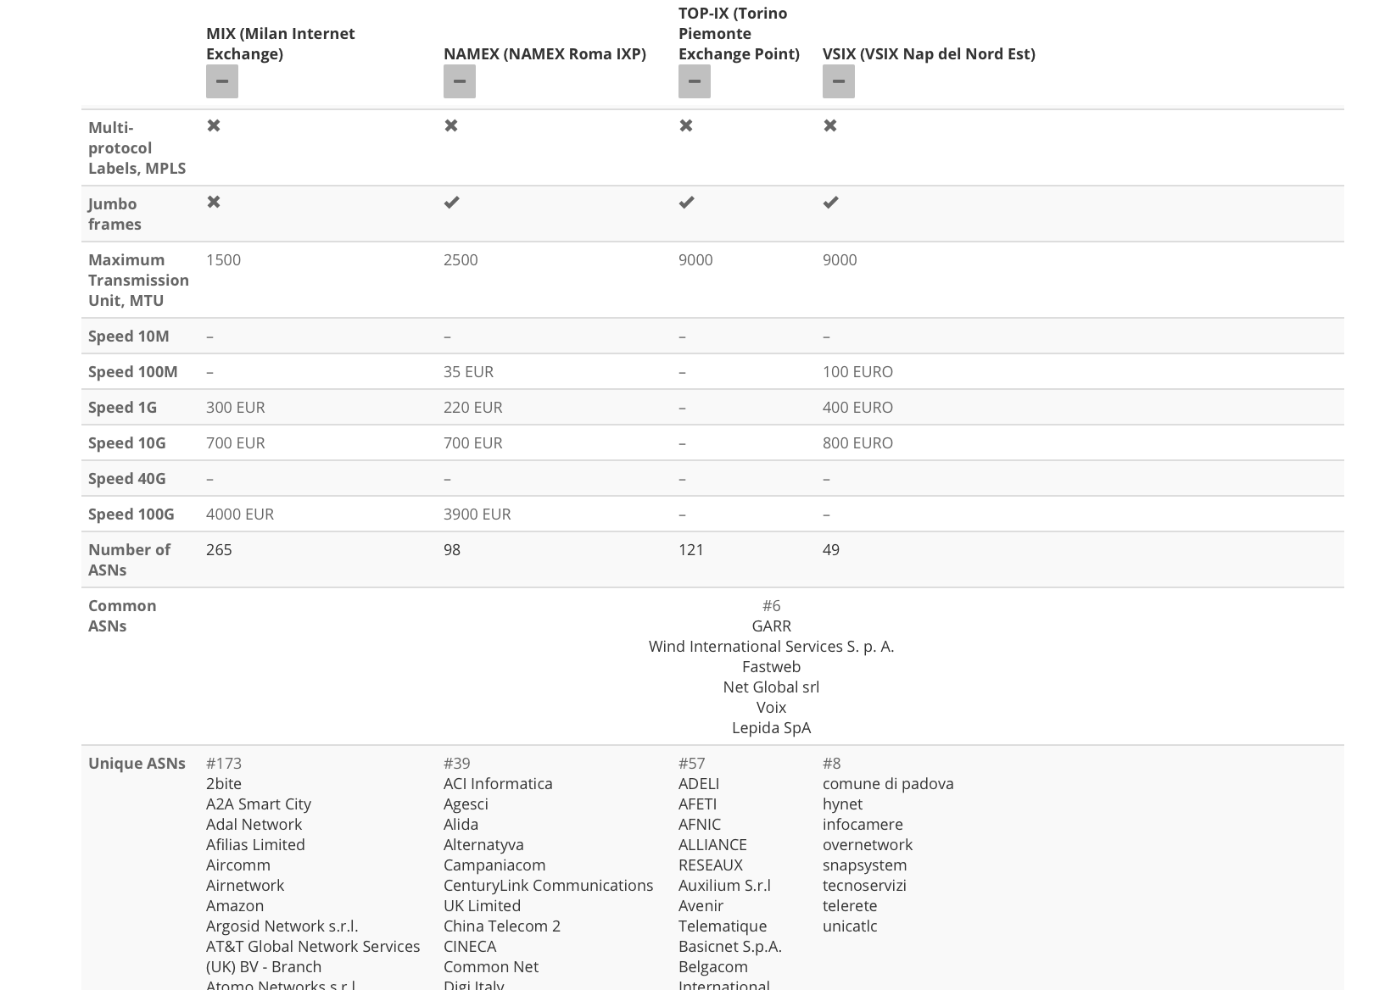
What we’ve been working on – Compare IXPs

Slide 15
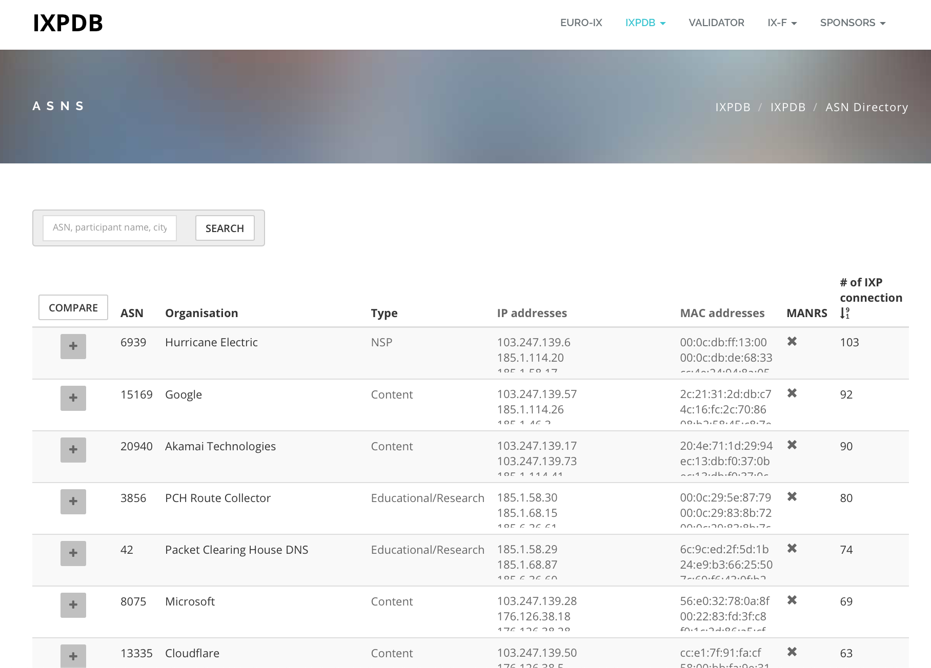
What we’ve been working on – Compare ASNs

Slide 16
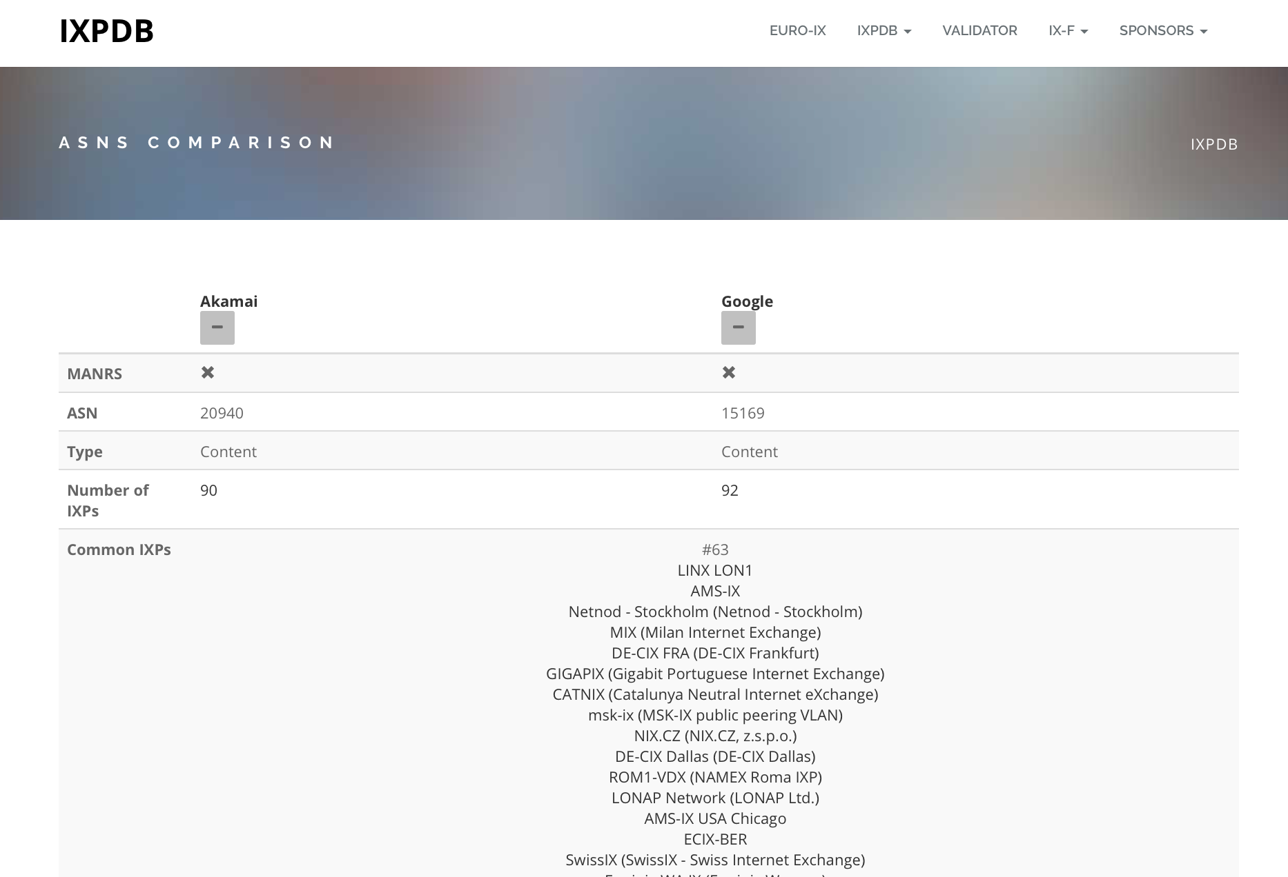
What we’ve been working on - Compare ASNs

Slide 17
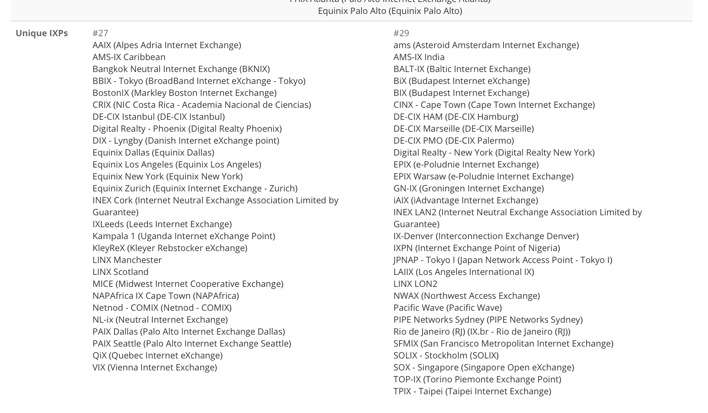
What we’ve been working on - Compare ASNs

Slide 18
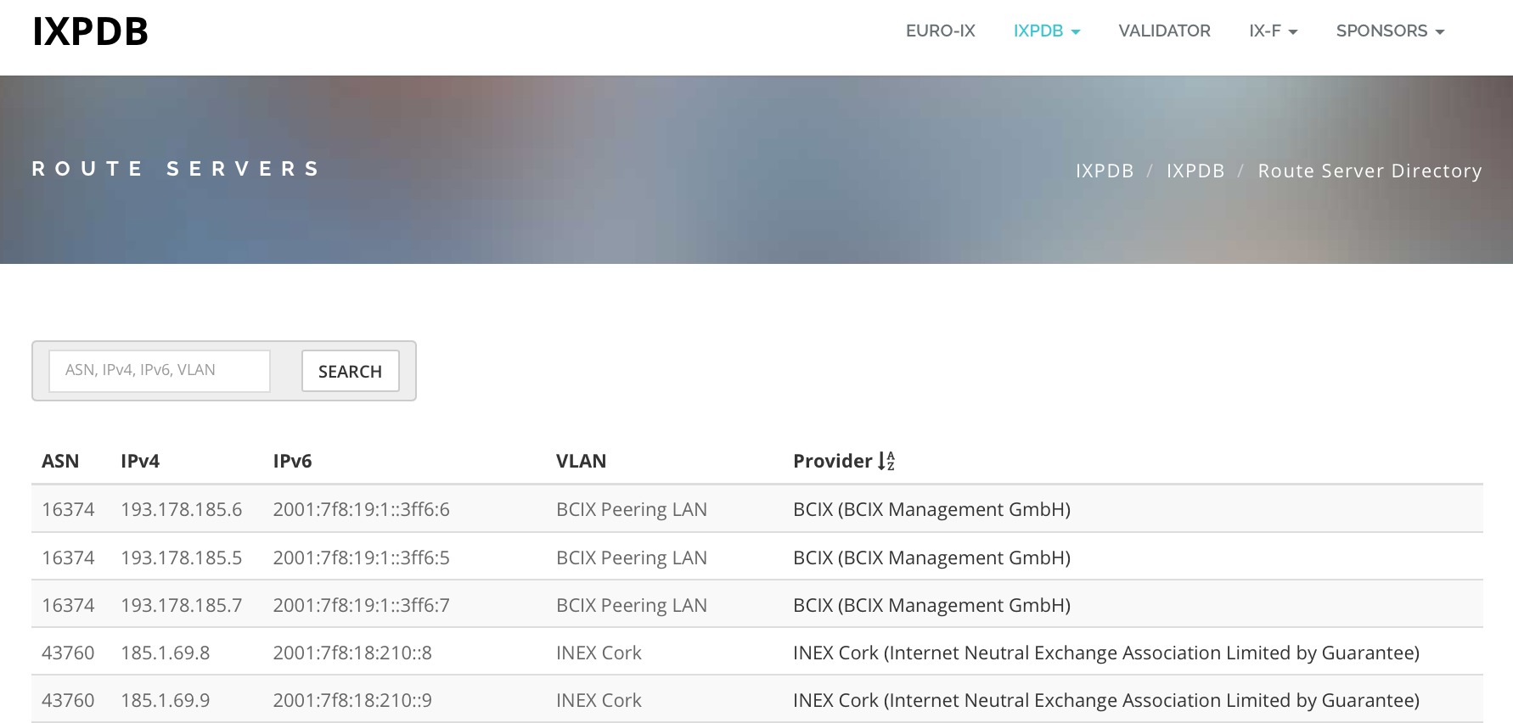
What we’ve been working on - Route Server Directory

Slide 19
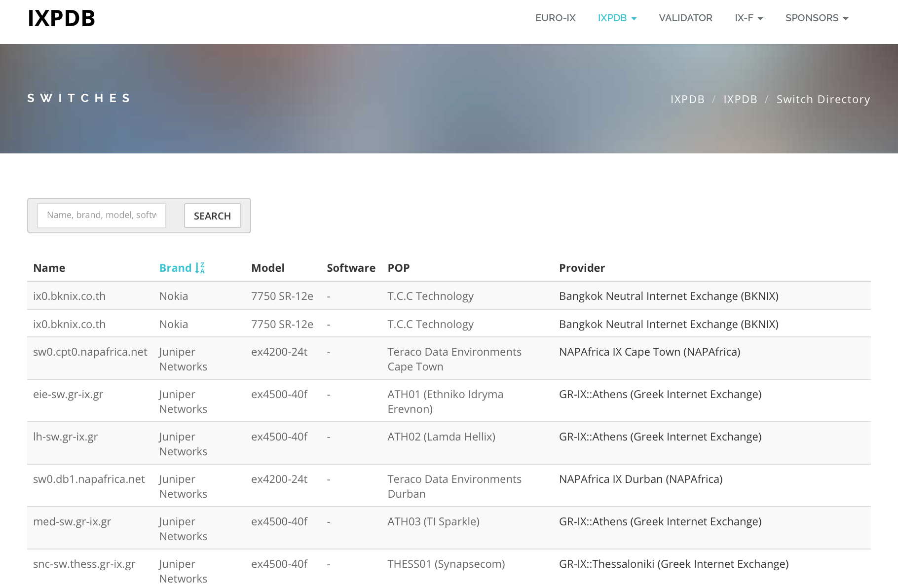
What we’ve been working on - Switch Directory

Slide 20
What’s next
New JSON spec to be published
  Further Route Server & Switch data
Authentication – IXPs can choose what data they want public and private (IXPs/Members only)
API work with Route Servers – prefix / ASNs
Analysis tools, mappings, searches by city / country
Work with IXPs to implement a solution – how to guides / tutorials / IXP Manager / Asteroid / Support from other IXPs
You too can help, speak to your IXPs
95 exports today!

Slide 21
Other Information
Mailing list for users - https://lists.euro-ix.net/mailman/listinfo/ixpdb
JSON Member List Schema – https://github.com/euro-ix/json-schemas
API – https://api.ixpdb.net
IXPDB admin team - ixpdb-admin@euro-ix.net
If you think this is good work like we do, support us!
secretariat@euro-ix.net

Slide 22




IXPDB Sponsors

Slide 23
Thank You

