Slide 1
Configuration Management in the NTT Com Global IP Network
ITNOG 5
Shawn Morris
VP - Systems, Applications, and Software

Slide 2
Who We Are
Global IP Network (GIN)
AS2914
NTT Com’s wholesale IP backbone
105 POPs in 28 countries on 5 continents
Offering IP transit and L2 pseudo-wire services
Bulk of customer traffic is on 10GE and 100GE
Using Juniper MX2k, PTX1k, and Cisco ASR9000

Slide 3
Are we talking about SDN?

Slide 4
What is SDN?
“Software-defined networking (SDN) is an approach to networking that centralizes control of the network by separating the control logic to off-device compute resources. This enables operators to use programmable control to orchestrate and automate network services without having to physically access the network’s hardware.” – SDN Central

Slide 5
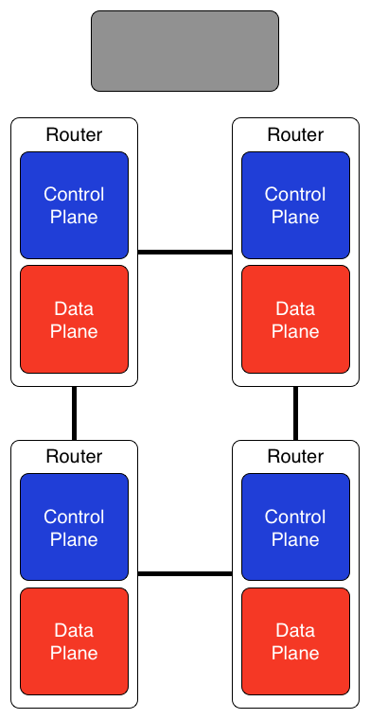
Traditional Network

Slide 6
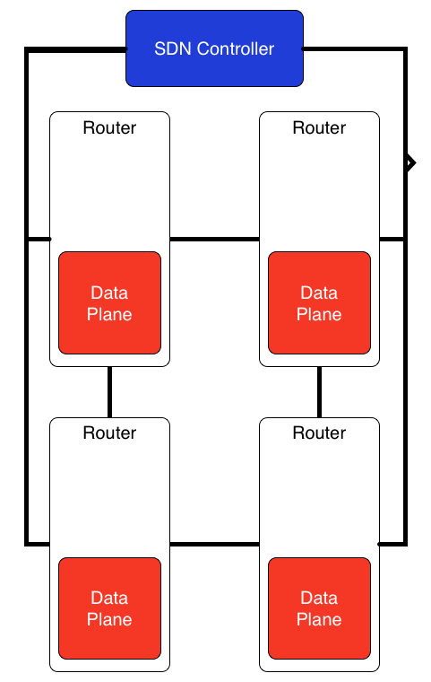
Software Defined Network

Slide 7
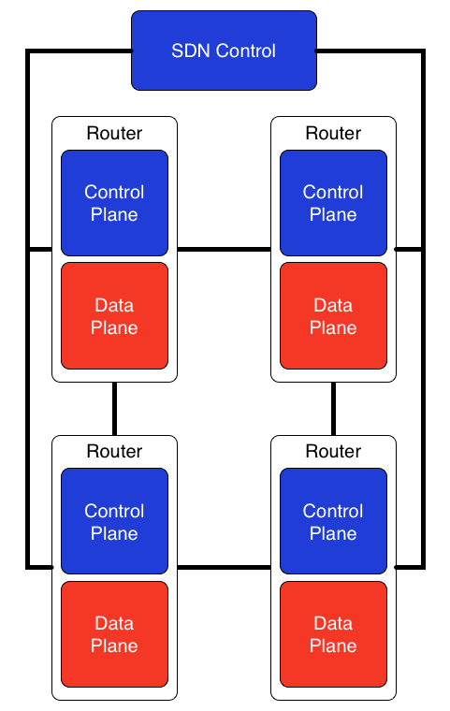
Hybrid SDN

Slide 8
Is SDN Important?

Slide 9
Automation Matters
Reduces training burden
Minimizes peer review
Aids in cost control
Leads to higher quality of service
Lower error rates (particularly catastrophic errors)
Consistent service delivery
Faster moves, adds, and changes
Customer-initiated service delivery

Slide 10
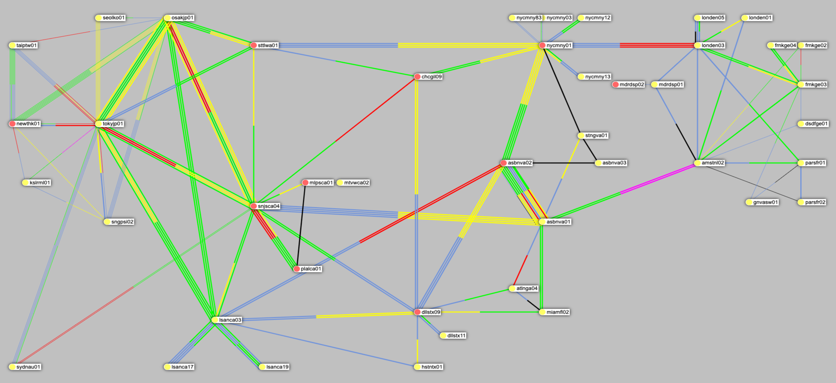
GIN 2009

Slide 11
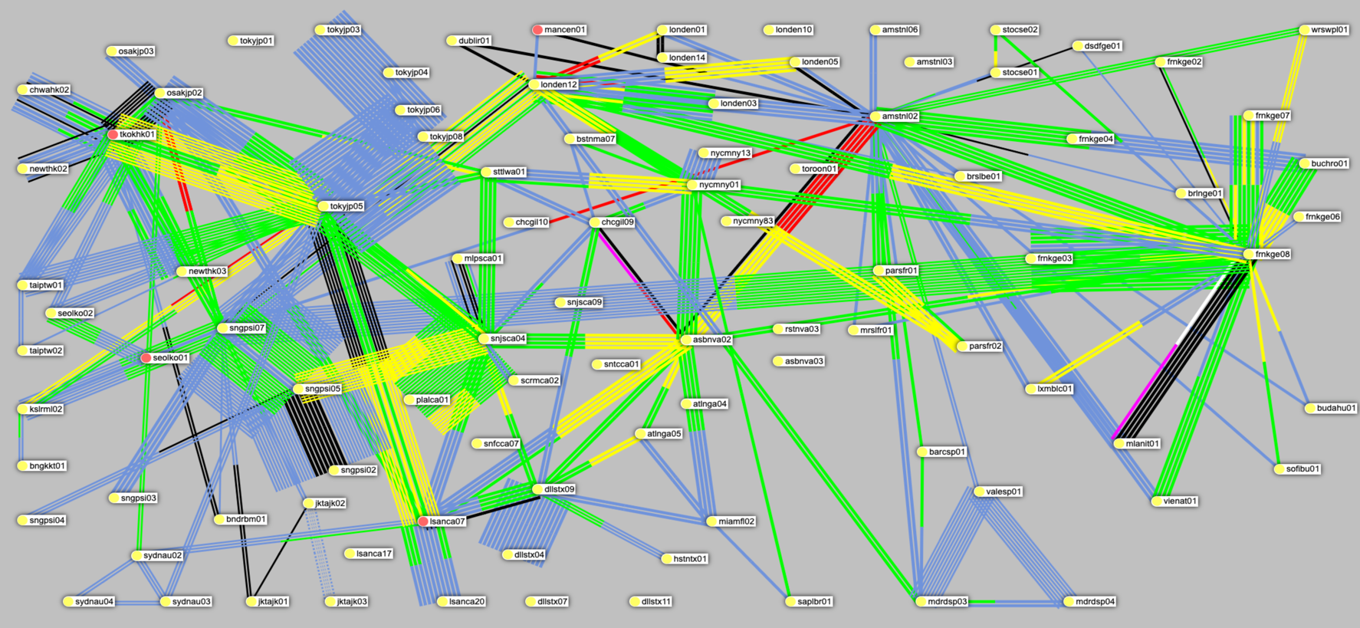
GIN 2019

Slide 12
GIN Network Automation

Slide 13
GUMS Overview
GIN Unified Management System
Homegrown
Started in late 1990’s at Verio
Originally developed by the IP engineering staff
Currently manages 500+ network elements
Driving fully automated (not autonomous) network configuration
Development is now done by a dedicated team
Currently version is 5.13

Slide 14
“fully automated network configuration”?
Database-driven configuration management
Device-ready configurations built from the DB
Brute force configuration deployment
Server-side configuration is canonical
No persistent manual configuration on the devices
Developing NETCONF-based configuration for next-gen DWDM network

Slide 15
Brute force configuration management
Entire device configurations are generated on the server
Configurations are pushed to the router via scripts built on RANCID
“commit replace” is used on IOS-XR
“load update” is used on JUNOS
Each device has a “.conf” file in revision control where manual configuration can be stored

Slide 16
NETCONF?
It didn’t exist
It doesn’t solve the hardest problem in network automation (How do I ensure I’ve gone from “current state” to “desired state”)

Slide 17
Tech Stack
Postgres
M4 Templates
C binary with custom M4 processor for building configurations
Makefiles to drive configuration builds
CVS repository per config group to store “.conf” files
Web application built on perl and catalyst
Read-only REST API
Scripts built upon RANCID for deploying configurations
Still running RANCID
Running configurations
All GUMS-built configurations

Slide 18
GUMS Workflow
SQL Database
M4 Macros
Config File
Router
User enters database changes via Web UI
User initiates config build via make command on server
User initiates config push via loadconfmem command on server
Router is contacted by script via SSH
Router requests configuration file from server via FTP
Configuration is committed

Slide 19
GUMS Evolution
Original purpose was using m4 to build BGP policy
First use of a database was to store configuration knobs
Much of the config was typed freehand into text files
Certain repeated config bits were migrated into macros
With GUMS v2 interfaces moved into the database

Slide 20
include(`JNX.m4')dnl
define(`myLOOP',`129.250.0.45')dnl
PLATFORM(juniper,martini)dnl
#
# Verio / PAIX Palo Alto, CA Unauthorized Access is Prohibited
# pao6.verio.net 2000.05.17-0 For Service Call (800) 551-1630
#
@`SERVICES'(myHOST)
SERVICES()dnl
NAMESERVERS()dnl
LOGGING()dnl
USERS()dnl
SNMP(,`PAIX')dnl
#
interfaces {
so-1/0/1 {
description "BB: pvu0 p1-0-0-0 - PAIX c34-r4-s3-s-b2b-b3-19-20/MFS o2-brt-u88-0001/Q spa-3003095/ELI oc-obgl-105143-003-elg";
clocking external;
encapsulation cisco-hdlc;
sonet-options {
fcs 16;
payload-scrambler;
}
unit 0 {
point-to-point;
family inet {
no-redirects;
address 129.250.3.25/30;
}
COST(13, `so-1/0/1', `BB: pvu0 p1-0-0-0')dnl
PIMMODE(`sparse-dense', `so-1/0/1.0', 1)
}
}

Slide 21
@DEVICE(myHOST())dnl
PLATFORM(hfr,mcast)dnl
dnl
!
@BANNER(myHOST())dnl
!
SERVICES(`loopback0')dnl
!
dnl ENABLE()dnl
!
@R_POLICY(myHOST())dnl
!
dnl NETFLOW must be defined before INTERFACES
_NETFLOW(_COLLECTOR1())dnl
!
@INTERFACES(myHOST())dnl
!
@CLNS(myHOST(), `verio',12,`wide')dnl
!
dnl @MPLS(myHOST())dnl
!
@STATICS(myHOST())dnl
_BLACKHOLE()dnl
!
@L2VPNU(myHOST())dnl
!
IPEERS(myHOST())dnl
!

Slide 22
GUMS Evolution (cont.)
We were able to abstract our configurations so that they could be moved between platforms seamlessly.
We moved from knowing router configuration commands to knowing database tables.
We made many fewer configuration errors.
We still did not handle concurrent configurations gracefully.
We still had to write the templates in M4
We still had to click through dozens of screens to configure anything moderately complex

Slide 23
GUMS Present and Future
We have deployed service-based provisioning tools
We have started development of GUMS v6
Python-based config generation engine
Templates will not be in M4 (currently experimenting with Jinja2)
Queue-based management of builds and deployments

Slide 24
LAG Tool
The basis of most GIN infrastructure is Link Aggregation Groups
Configuring an infrastructure LAG used to take many screens
LAG interface (IPv4, IPv6, ISIS, description, etc.)
Member interfaces (MTU, LACP, description, etc.)
Much of this information was repeated (LACP, parts of the description, etc.)
Much of the information is pre-determined (e.g. MTU)
So we built a tool where it all could be configured or edited in a single screen.

Slide 25
Before

Slide 26
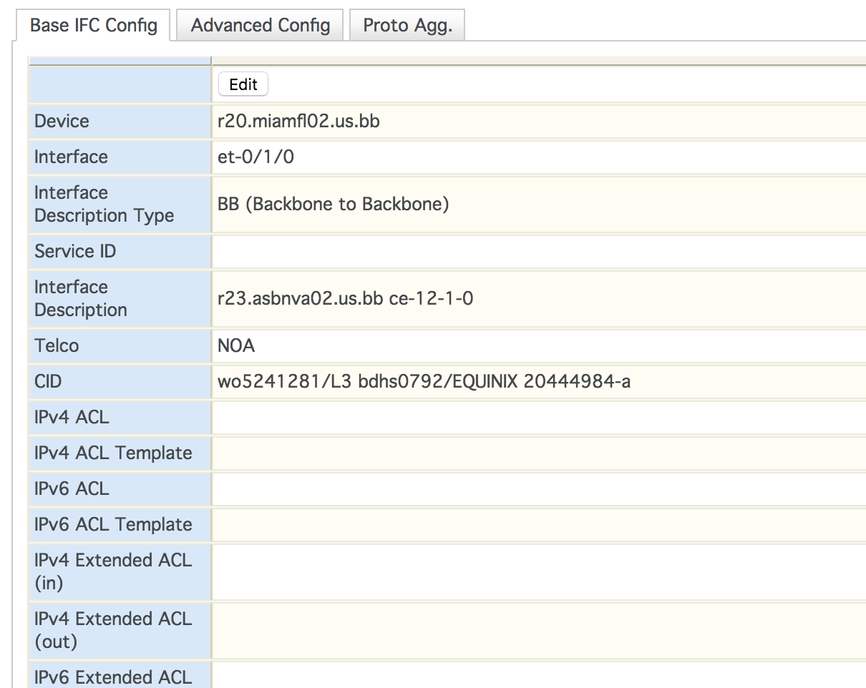
Before

Slide 27
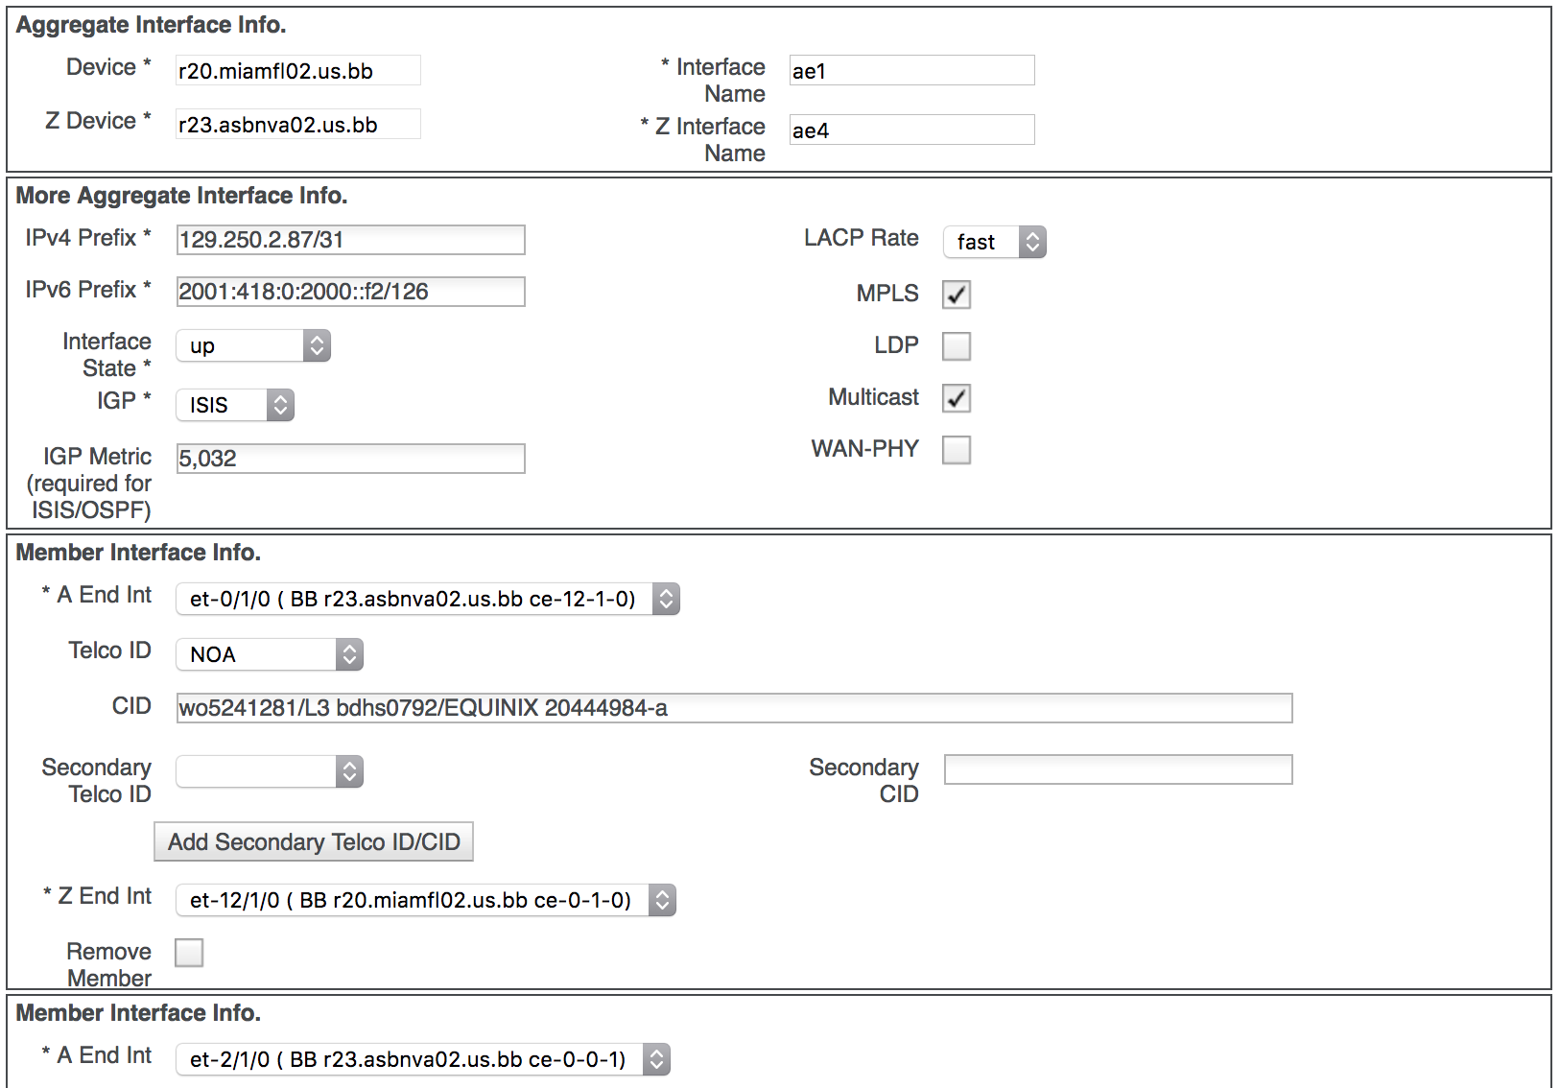
After

Slide 28
Another Problem
GIN has an extremely large volume of Move, Add, Change activity
This work happens in the middle of the night when minds are not the sharpest.
It is not uncommon for a maintenance to involve moving dozens of connections in a 3-hour window
Changing configurations was becoming a gating factor during maintenance.

Slide 29
Migration Tool
We built a tool so that migration engineers could do the majority of their configuration work during daylight hours when they’re at their sharpest
Configuration changes can be queued during the day
Open ports where services will be moved are reserved
An already fast MAC process has been further improved.
Can now move hundreds of ports in a 4-hour maintenance window

Slide 30
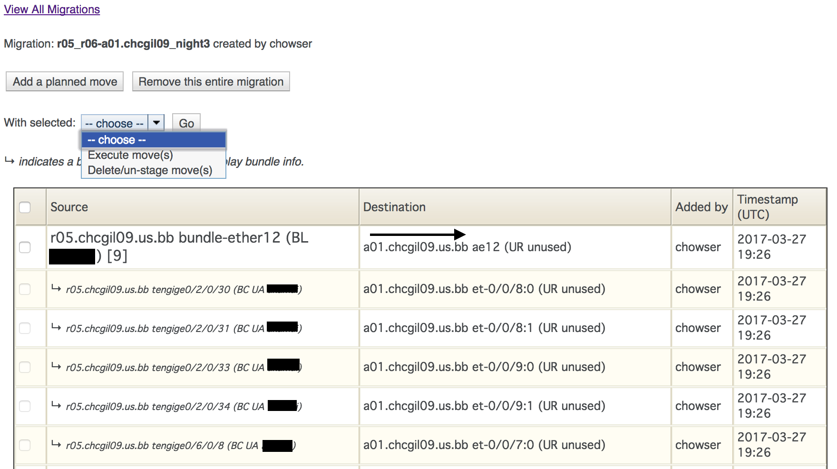

Slide 31
What About Your Network?

Slide 32
Basic Facts
There will be development work
There has to be organizational buy-in
Powerful open-source infrastructure is available (e.g. OpenDaylight, NAPALM)
You don’t have to do it all at once

Slide 33
Start Simple
Go watch Leslie Carr’s talk at NANOG about NetDevOps (http://bit.ly/2o8KYw0)
Run RANCID
Put your configurations in revision control (e.g. git, svn)
Learn some scripting/coding (bash, python)
Start researching open-source projects

Slide 34
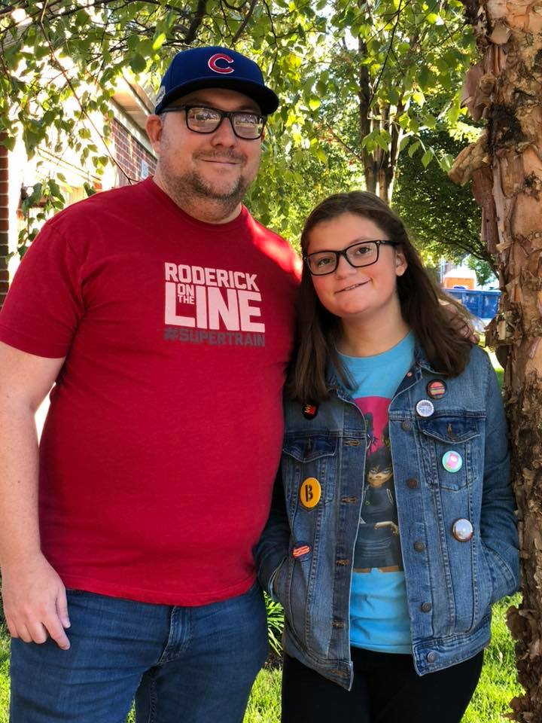
Shawn Morris
VP – Systems, Applications, and Software
shawn@ntt.net
http://www.gin.ntt.net/
@GinNTTnet

