Slide 1
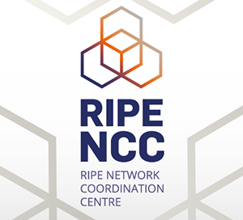
RPKI: a practical guide
securitas securitate mutua paciscenda est
Flavio Luciani - NAMEX
Marco Paesani – Fiber Telecom
Massimiliano Stucchi – Ripe NCC
ITNOG5 - Bologna, 10th May 2019

Slide 2
Internet routing
What we call “The Internet” is actually an interconnection of autonomous, independent networks which use BGP to exchange routing information
BGPv4, 1994
No built-in security in BGP protocol
IRR
AS1=193.x.x.x
AS2=195.x.x.x
query
query
AS 1
193.x.x.x
AS 2
195.x.x.x

Slide 3
Incidents are common
A route leak or a route hijacks is defined as the illegitimate advertisement of an IP space
2018 routing security review
12.6k incidents
4.4% of all ASNs affected
3k ASNs victims of at least one incident
1.3k ASNs caused at least one incident
source: https://www.bgpstream.com/

Slide 4
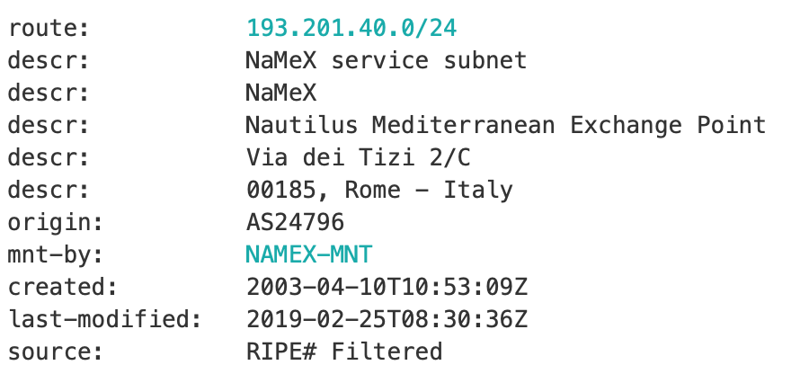
Limitations of the Routing Registry
Many exist, most widely used
Ripe database
RADB
....
Not every RIR has a IRR
No verification of holdership over resources
The IRR system is far from complete (obsolete data)

Slide 5
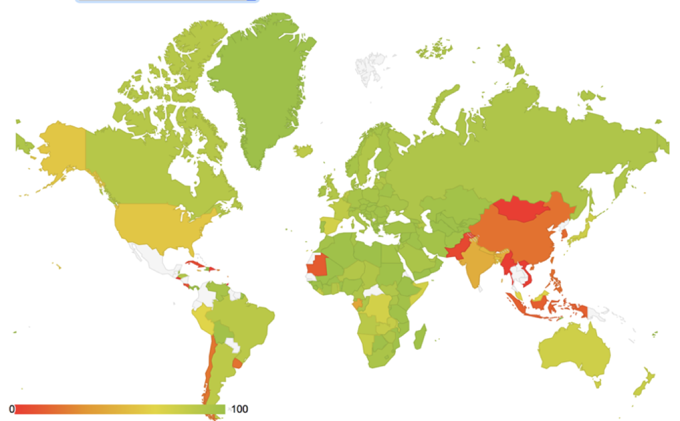
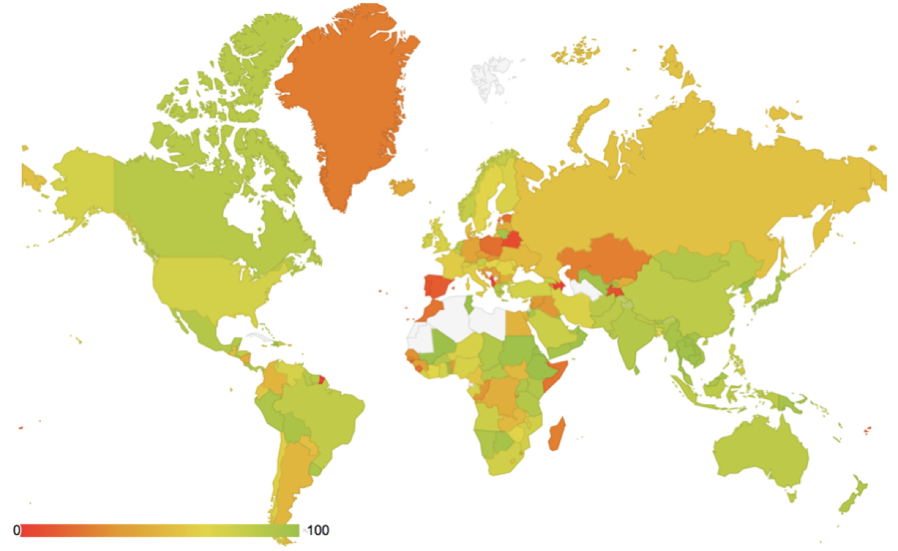
Accuracy
RIPE IRR
RADB IRR

Slide 6
What is RPKI (1)
Resource Public Key Infrastructure is a PKI framework designed to secure the Internet Infrastructure
Helps to secure Internet routing by validating routes
The 5 RIRs hold a self-signed root certificate for all the resources they have in the registry
The root certificate is used to sign a certificate that lists your resources
The certificate hierarchy follows the same structure as the Internet Number Resource allocation
All certificates are published in publicly accessible repositories

Slide 7
What is RPKI (2)
RPKI uses X.509 certificates with extensions for IP addresses and AS identifiers described in RFC 3779
In RPKI, certificates do not include identity information, they only purpose is to transfer the right to use Internet Number Resources
LIRs are allowed to obtain a resource certificate listing the Internet number resources they hold, including their own public key (https://portal.ripe.net/rpki-enduser)
LIRs can then create cryptographic attestations about the prefixes they would announce (https://my.ripe.net/#/rpki)
These attestations are called Route Origin Authorizations (ROAs), signed prefixes

Slide 8
Route Origin Authorisations
Digitally signed objects that associate one AS to one or more blocks of IP addresses
ROAs state which AS is authorised to originate certain IP prefixes
ROAs are published in the same repositors as certificates
LIRs can create a ROA for each of their resources (IP address ranges)
Multiple ROAs can be created for an IP range
Prefix
the network for which you are creating a ROA
Origin ASN
The ASN supposed to be originating the BGP announcement
MAX LENGTH
The maximum prefix length accepted for this ROA

Slide 9
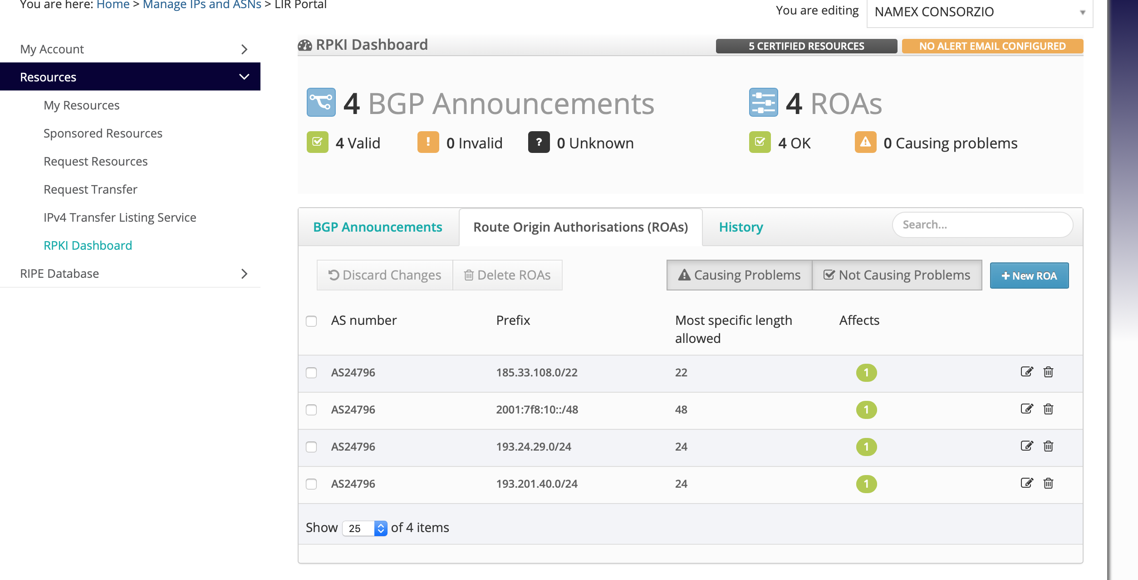
Hosted RPKI solution
RIRs decided to provide a hosted RPKI solution to lower the barrier into the technology
Hide all the crypto complexity
Just focus on creating and publishing ROAs
Easy-of-use in terms on maintenance and flexibility
Users login into the RIR member portal and request a resource certificate

Slide 10
Route Origin Validation
A dedicated software (validator) downloads a local copy of all signed objects from the RIRs
The result is a list of all valid combinations of ASNs and prefixes, the “validated cache”
Validated ROA contents are called “Validated ROA Payload” (VRPs)
Routers query the validator software (rtr protocol) to check for prefixes validity
RIRs
AFRINIC
RIPE NCC
ARIN
LACNIC
APNIC
rsync/rrdp
RPKI RTR PROTOCOL
VALIDATOR
ROUTER

Slide 11
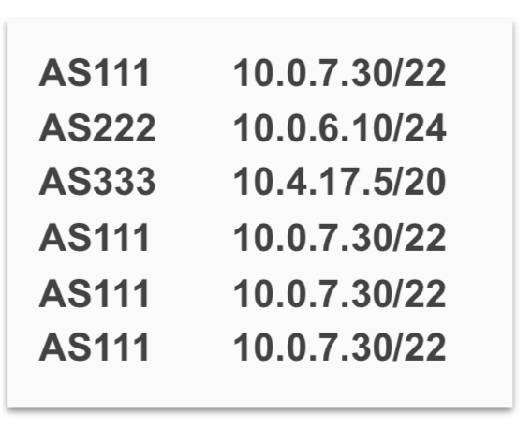
The decision process
When you receive a BGP announcement from your peers, you can compare this to the validated cache
There are three possible outcomes:
Unknown: there is no covering ROA for this prefix
Valid: A ROA matching the prefix and ASN in found
Invalid: There is a ROA but it does not match the origin ASN and/or maxLength
Based on this and on BGP announcements, you can instruct your router to make some decisions:
modify LP
Filter the announement
....
BGP ANNOUNCEMENTS
ROA
ROA
ROA
ROA
BETTER ROUTING DECISION

Slide 12
RPKI Validator Software
Routinator
https://www.nlnetlabs.nl/projects/rpki/routinator/)
Ripe NCC Validator
https://www.ripe.net/manage-ips-and-asns/resource-management/certification/tools-and-resources
OctoRPKI
https://github.com/cloudflare/cfrpki#octorpki
rcynic
https://github.com/dragonresearch/rpki.net

Slide 13
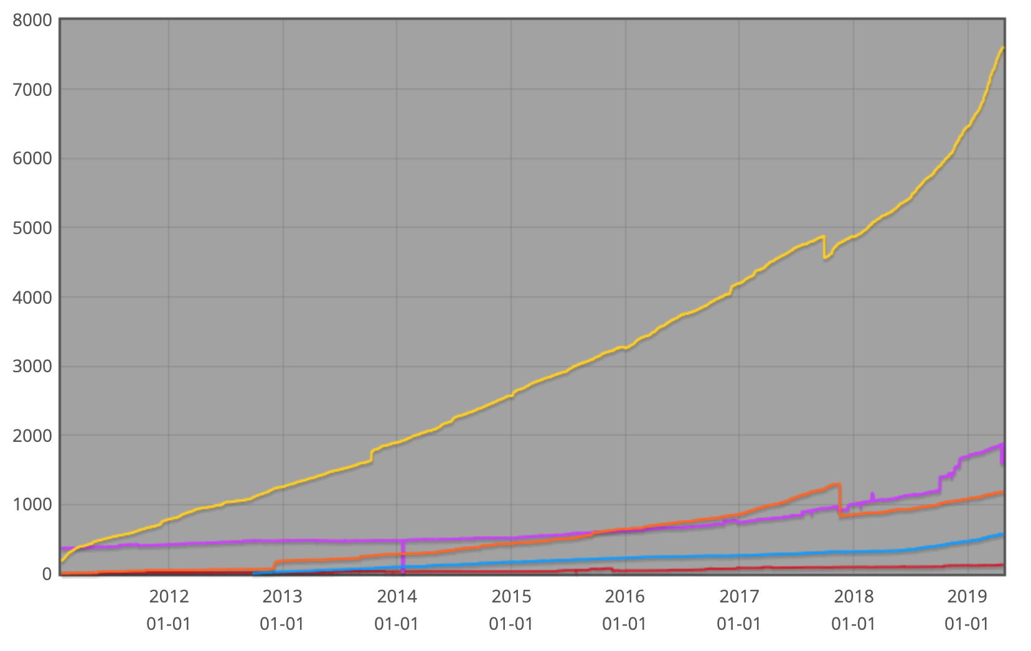
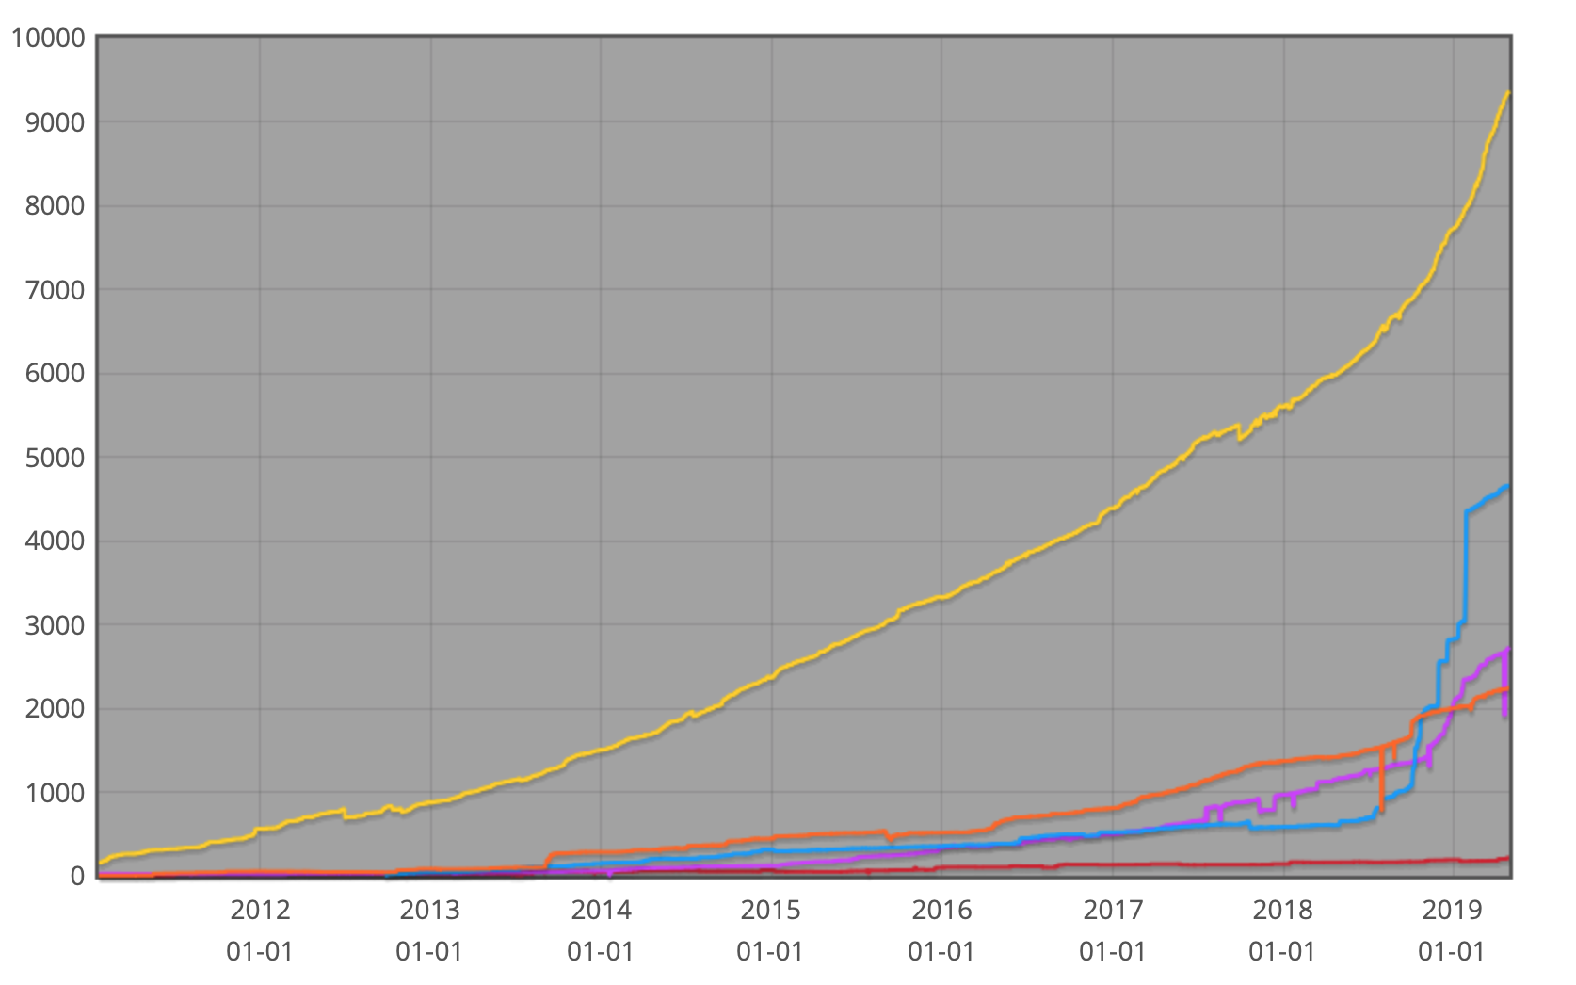
Statistics
NUMBER OF CERTIFICATES
NUMBER OF ROAs
RIPE NCC: 7632
RIPE NCC: 9375
APNIC: 1885
APNIC: 2732
LACNIC: 1184
LACNIC: 2241
ARIN: 577
ARIN: 4655
AFRINIC: 132
AFRINIC: 215

Slide 14
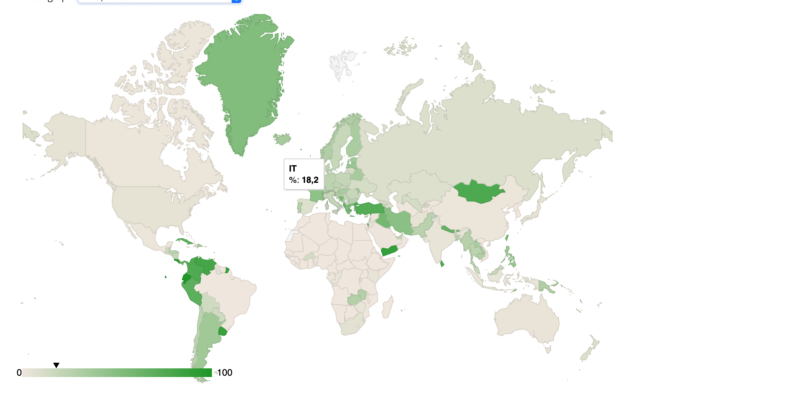
ROAs for Italian Resources
Valid ROAs: 742
Invalid ROAs: 29
Invalid ROAs wrong ASN: 5
Invalid ROAs wrong length: 24
Unknown ROAs: 3906

Slide 16
Implementazione
Support for Origin Validation and RPKI-RTR (draft form) first added in Junos 12.2R1 (September 2012).
And all subsequent releases
Currently:
RFC 6810 (“The Resource Public Key Infrastructure (RPKI) to Router Protocol”),
RFC 6811 (“Prefix Origin Validation”)
draft-ietf-sidr-origin-validation-signaling-08.
Supported on all products (physical and virtual) running Junos.
Implementazione validazione RPKI "up & running”
Network: Fiber Telecom AS 196753
Routers: MX960 con JUNOS ver. 18.1R3-S3.8
RPKI cache: RIPE RPKI Validator

Slide 17
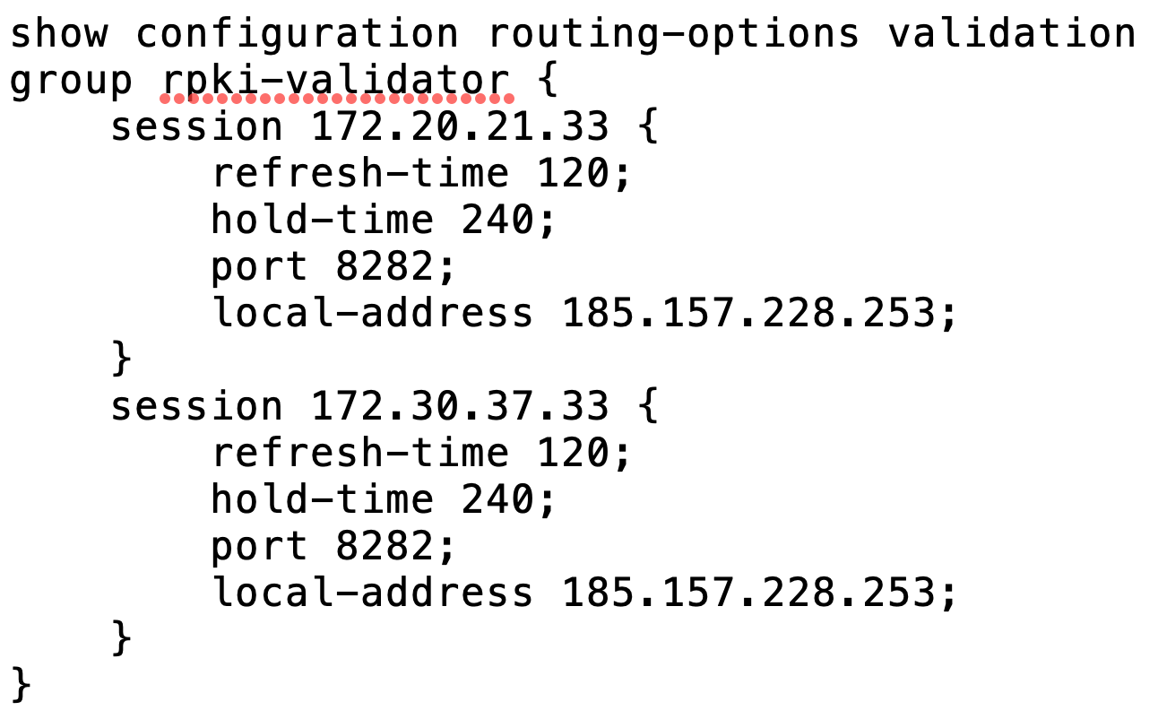
Local RPKI Cache
Configuriamo la Local RPKI Cache (dinamica)
La configurazione del local potrà essere IPv4 e/o IPv6
Massimo due sessioni di validazione

Slide 18
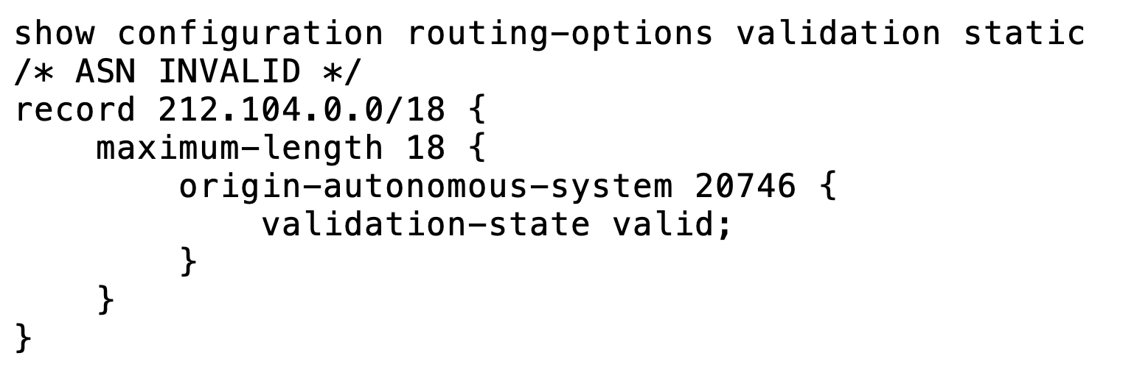
Static entry
Configuriamo una rete (statica)
Definiamo le reti RPKI localmente sul router
Problema realmente accaduto a marzo 2019

Slide 19
Validazione delle reti
La validazione della rete viene definita come una normale policy di Junos verificando il contenuto del validation-database
La configurazione della policy funzionerà normalmente:
impostando il valore della variabile (validation-state variable)
impostando un altro stato (origin-validation-signaling community)
accettando, rifiutando o modificando la LocalPref
............

Slide 20
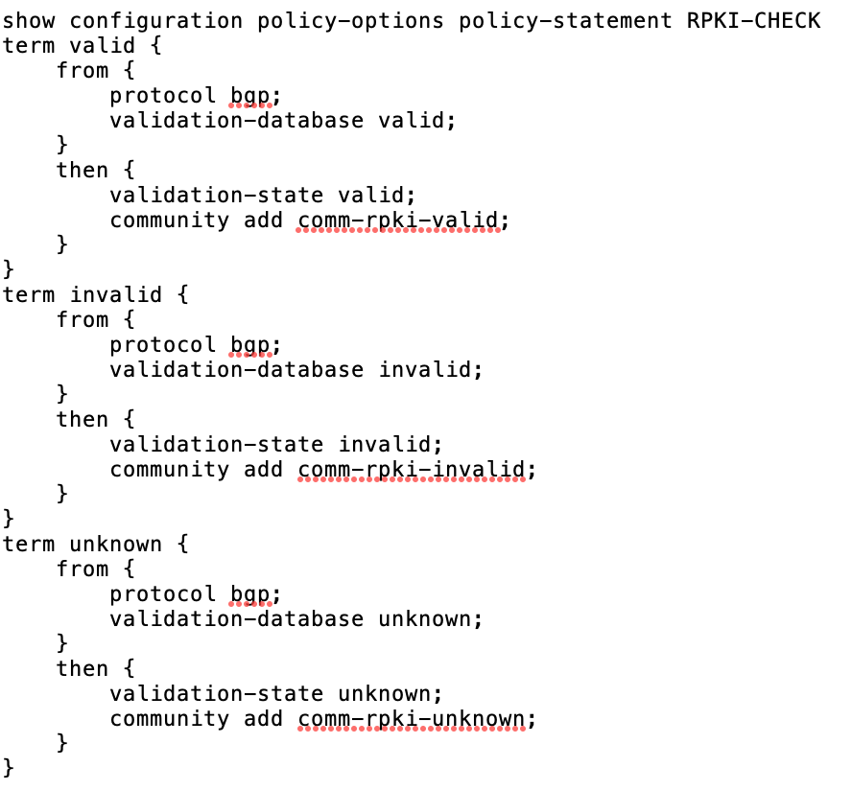
Configurazione della policy RPKI
La validazione della rete viene definita come una normale policy di Junos verificando il contenuto del validation-database

Slide 21
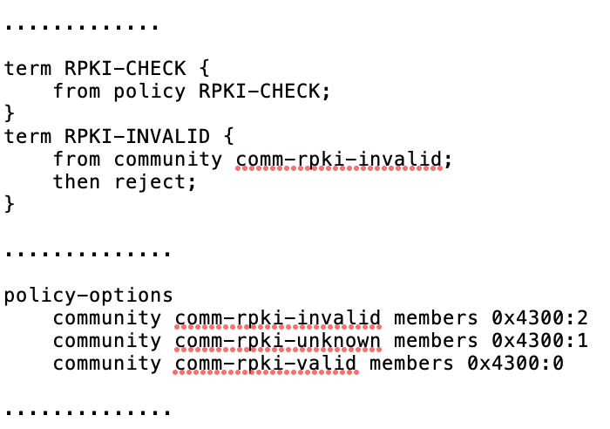
Configurazione della policy di import e community
Le comunity sono indicate su RFC 8097
Valore in decimale 17152:X

Slide 22
Management and troubleshooting
Show commands
show route
show validation statistics
show validation database
show validation replication
show validation group
show validation session
Request validation policy
Re-run validation, optionally against only specified routes

Slide 23
Show route

Slide 24
Validation states
Gli stati di validazione interni al router (RFC 6811)
valid
invalid
unknown
C'è anche un altro stato “validation was not run against this at all”
unverified
Unverified è differente da unknown
La parte di rete internal BGP sarà unverified (best practice)

Slide 25
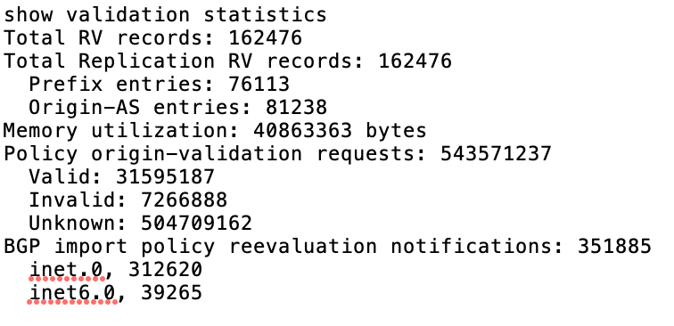
Show validation statistics

Slide 26
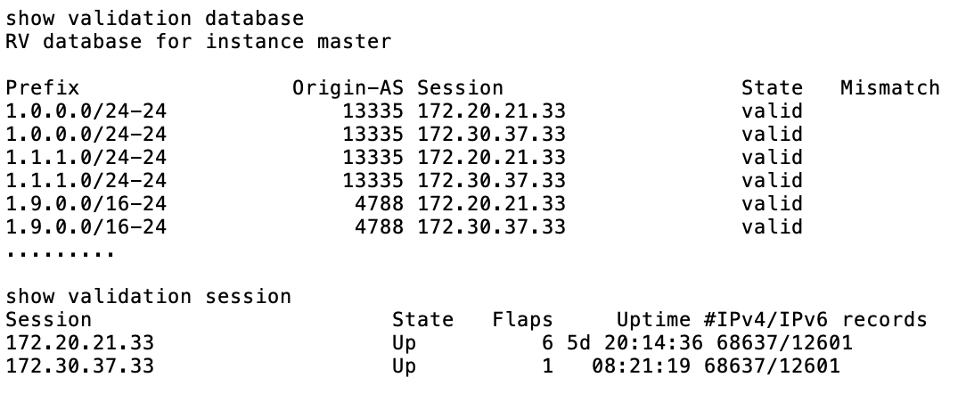
Show validation database & session

Slide 27
Conclusioni
adottare RPKI-validation è una valida soluzione per problemi DDoS
adottare anche tutte le altre best practice per filtrare le rotte BGP
consiglio validazione OOB su network privato
informare e aggiornare i colleghi del NOC e documentare l’implementazione
configurare sempre rpf-check in modalità loose sulle interfacce esterne
non installare la default (IPv4 0.0.0.0/0 e/o IPv6 ::/0)
configurare quanto prima sul tuo backbone RPKI

Slide 28
Q&A?
THANKS!
Flavio Luciani – f.luciani@namex.it
Marco Paesani – m.paesani@fibertelecom.it
Massimiliano Stucchi – max@stucchi.ch

