Slide 1
Modelli di Controllo e Mitigazione
per Attacchi DDoS
Filippo Farina
EMEA Carrier Solution Architect
ITNOG5 - May 10th, 2019

Slide 2
DDoS Security Trends
Anti-DDoS Solution Pillars
Reference Architecture

Slide 3















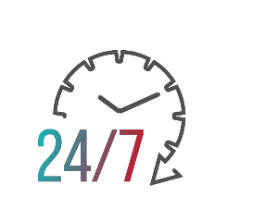
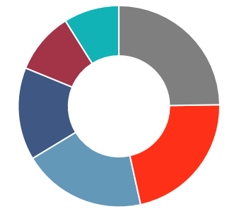
Radware Annual Security Reports
SOURCE #1
Radware Industry Survey
1,100
Retail & eCommerce
1,000-
2,999
5%
550-
999
8%
10,000+
25%
Technology, SP & Carriers
Financial Services
3,000-9,999
13%
Education
<100
22%
31%
18%
18%
33%
Govt & Civil Service
100-499
17%
NORTH
AMERICA
CENTRAL/SOUTH AMERICA
EMEA
APAC
Healthcare
Number of Employees
SOURCE #2
ERT Threat Research Center
Radware security researchers, threat hunters and malware analysts
Global Threat Deception infrastructure detecting
and qualifying active attacks
2018 real-life attack data from Radware ERT experts and cloud customer network
Notes:
This threat landscape analysis is based on Radware global industry studies – its newly launched annual Global Application and Network Security Report as well as a recent Web Application Security Study.
Both include insights from nearly 1100 network security professionals from the hands-on engineers to CISO, CIOs and CTOs
The participant population is diverse and include organizations from all around the globe, all industries and all company sizes.
Another primary source is real experiences of actual attacks our ERT experts have fought for our customers throughout the year, and the product of Radware’s threat intelligence arm, collecting and studying new threats, vulnerabilities and attack campaigns as they emerge.

Slide 4











ATTACKS ARE BECOMING MORE FREQUENT AND IMPACTFUL
93%
62%
54%
52%
15%
+
WERE ATTACKED
INCREASE IN DAILY ATTACKS
REPORT LOSS OF PRODUCTIVITY
INCREASE IN THE AVG. COST OF CYBER-ATTACK
IN COMPLETE OUTAGES

Slide 5




HOW ATTACKERS DISRUPT SERVICE
ATTACKERS CONSTANTLY DEVELOP EFFECTIVE TECHNIQUES TO CAUSE HARM
20%
15%
ATTACKS SHIFT TO THE APPLICATION LAYER
+
+
64%
HTTPS FLOODS
BURST ATTACKS
15%
10%
+
HIT BY APPLICATION LAYER ATTACK
DNS ATTACKS
MALWARE & BOTS
Source: Radware 2018-2019 Global Application and Network Security Report
Notes:
The primary goal of cyber-attacks is service disruption, followed by data theft. Service disruption obviously equals bad customer experience, and perpetrators know that and use a broad set of techniques to cause harm. Few such commons include bursts of high traffic volumes which do not leave time for mitigation teams to get a grip, usage of encrypted traffic to overwhelm security solutions resource consumption, and crypto-jacking that reduces the productivity of servers and endpoints by enslaving their CPUs for the sake of mining cryptocurrencies.

Slide 6



IoT BOTNETS CHANGE DDoS ECONOMICS
HIGH
VOLUME ATTACKS
HIGH VOLUME
COMPLEX ATTACKS
HIGH
COMPLEXITY ATTACKS
Encryption
Low & Slow
Encryption
Low & Slow
DNS
Reflection
Web
DNS
HTTP2
Headless Browsers
Amplification
NTP
Headless Browsers
Web
HTTP2
SSDP
Pre IoT
High complexity attacks are more expensive -> volume is lower (less available infected end points )
In the IoT Era
Vulnerable IoT devices form huge botnets running high complexity attacks
Notes:
The third trend is the rise of IoT-based botnets. These have really changed the attack vector landscape.
If in the pre-IoT era we had high volume attacks and separately high complexity attacks that targeted the application layer….
In the post IoT era, we now have high volume complex attacks – IoT opens up the opportunity for hackers to launch very high volume and also very complex attacks at the same time. We have seen the Mirai botnet that was introduced 2 years ago with some very unique and specific DNS attack vectors as well as additional vectors.
This level of sophistication and automation in attacks requires solutions that can accurately detect and mitigate – with the ability to deal with both volume and complexity without false positives. More traditional solutions that are rate-based or signature based alone, will not be able to deal with these attacks.

Slide 7
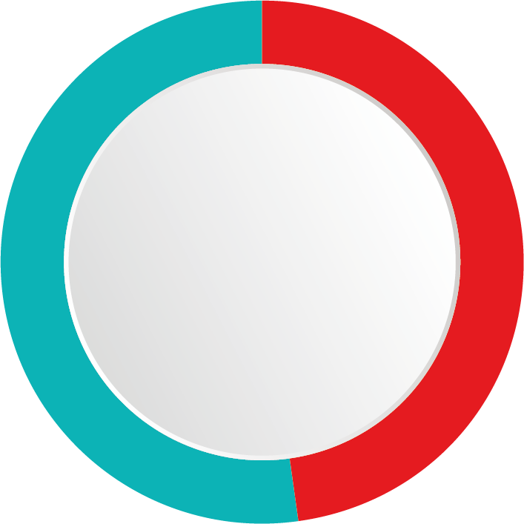


Bot Traffic Requires Investments
52%
Bot traffic
INTERNET
TRAFFIC
48%
Source: “TechRadar™: Application Security, Q2 2017”
Non-bot traffic
Copyright © 2019 Radware BotManager / Radware BotManager / ShieldSquare. All Rights Reserved.

Slide 8
DDoS Security Trends
Anti-DDoS Solution Pillars
Reference Architecture

Slide 9


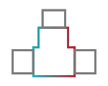



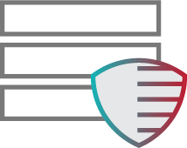

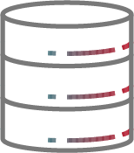

The Rise of the Multi-Vector Attack
“Low & Slow” DoS attacks (e.g. Slowloris)
ATO
Web Scraping
Denial of Inventory
XSS, CSRF
SQL Injections
Large volume network flood attacks
Brute Force
HTTP Floods
Network Scan
SYN Floods
App
Misuse
SSL
Floods
Internet
Pipe
Firewall
IPS/IDS
Load Balancer/ADC
Server
Under Attack
SQL
Server
Cloud DDoS Protection
DoS protection
Behavioral analysis
IPS
SSL protection
WAF
Anti-Bot

Slide 10




DDoS Mitigation Pillars
Detection
Workflow Activation
Mitigation
Reporting
External Triggers
Automation
Escalation Mechanism
Real-time mitigation
Volumetric/ Low&Slow vectors
Polymorphic attacks
Real-time Dashboards
Long-Term Reporting
Forensics Analysis
MSSP
Flow Sampling
Out-of-Path
In-line

Slide 11
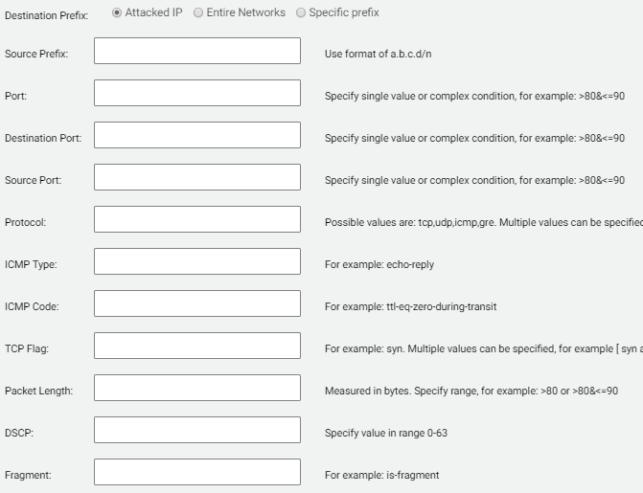
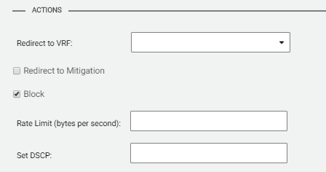
Network Based Mitigation: BGP-Flowspec
Dissemination of Flow Specification Rules – RFC 5577 (updated by RFC 7664)
  Automate inter-domain coordination of traffic filtering, such as what is required in order to mitigate (distributed) denial-of-service attacks
Flow Classification
Actions

Slide 12
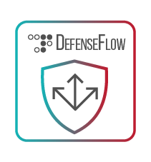

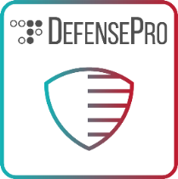
Multi-Layer Escalation Mitigation
Security Orchestrator
Border Routers
3
3PP Detection
BGP Flowspec
rules enforcement (mitigation actions)
BGP Flowspec
Attack Diversion
Attack Footprint
Core Routers
2
L4/L7 Surgical mitigation
1
Distributer Detection & Mitigation
Access Routers

Slide 13
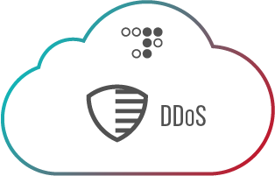
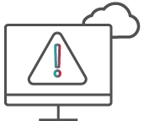


DDoS Protection Deployment Options
Always-on
On-Demand
Hybrid
Traffic always routed through Radware
Real-time detection & mitigation
DDoS detection based on:
  netFlow statistics
  Arbor TMS messages
  AWS and Azure telemetry
Traffic diverted only for volumetric attacks
Integrates on-premise + cloud
Real-time detection & mitigation
Traffic diverted to cloud upon pipe saturation
DefenseMessaging: unified signaling for on-premise appliances and cloud

Slide 14
DDoS Security Trends
Anti-DDoS Solution Pillars
Reference Architecture

Slide 15
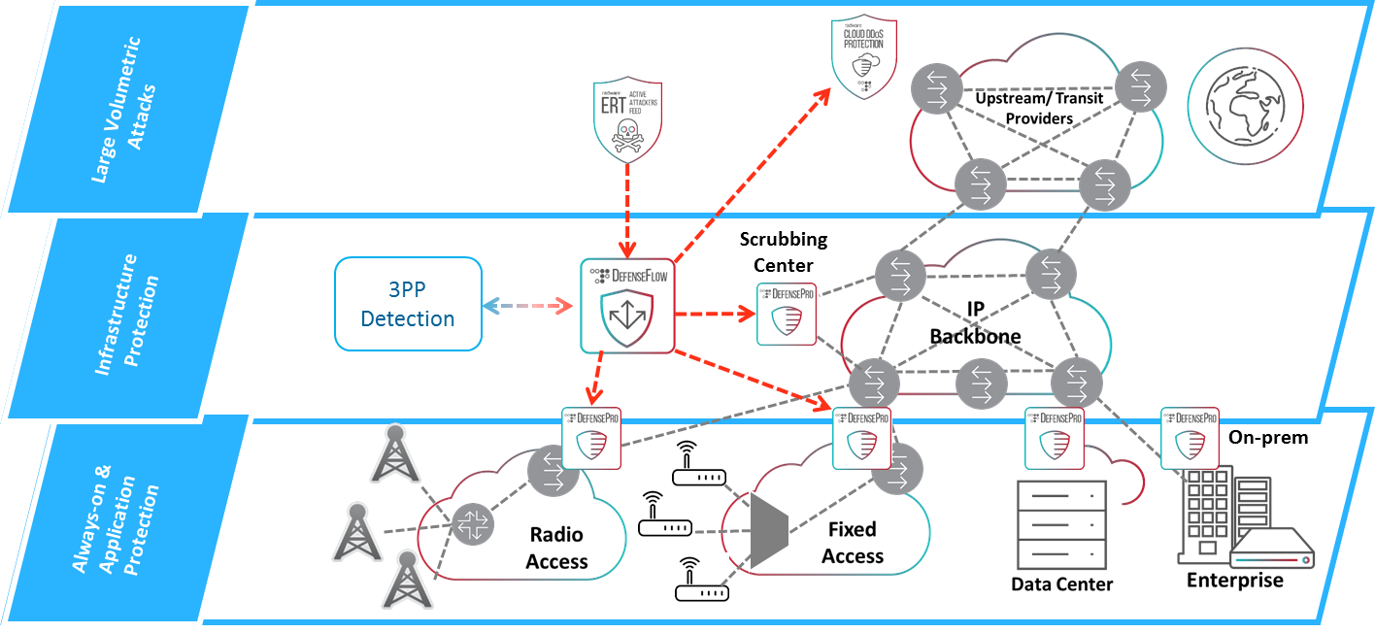
Multi Layer Protection Solution

Slide 16

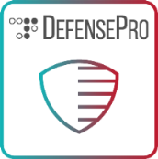
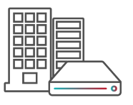

Use-Case 1: Selective SmartTap Protection
BGP-FS Mitigation
Per Protected Entity Workflow definition and activation
Selective per /32 diversion
Escalation Mechanism using BGP-FS
BGP Diversion
Mirrored Traffic
L4-L7 Traffic Inspection
Always-on Detection and Real-Time traffic characterization
Real-Time attack footprint generation
Dirty Traffic
CleanTraffic
Enterprise Customer
Data Center

Slide 17
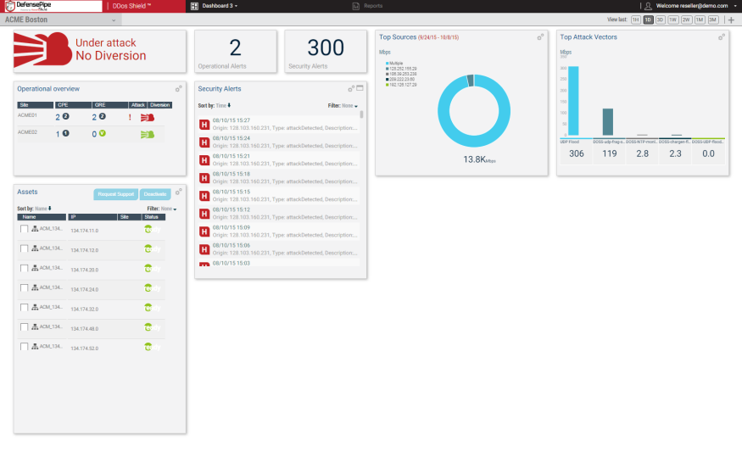

Use-Case 2: Scrubbing Center and 3PP Detection
Peering Point y
Peering Point x
Peering Point z
MSSP Portal
Flow-Based Detection
Netflow Sampling
1
Network Backbone
Scrubbing Center

Slide 18




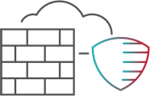








Security Features for E2E Protection
Security Services
WAF
DDoS
Protection
RADWARE ATTACK MITIGATION SOLUTION
Visibility & Analytics
Threat Intelligence
SSL
Protection
Anti Bot

Slide 19




Combining On-Prem and Cloud Protection
FULL
COVERAGE
of attacks across network & application layers
SINGLE TECHNOLOGY
across premise & cloud for unified protection & visibility
DEFENSE MESSAGING
between security elements for increased
accuracy
FLEXIBLE DEPLOYMENT –
premise,
on-demand, always-on
& hybrid
Integrated Multi-Layered Solution to Secure Data Centers & Applications

